Slide 1
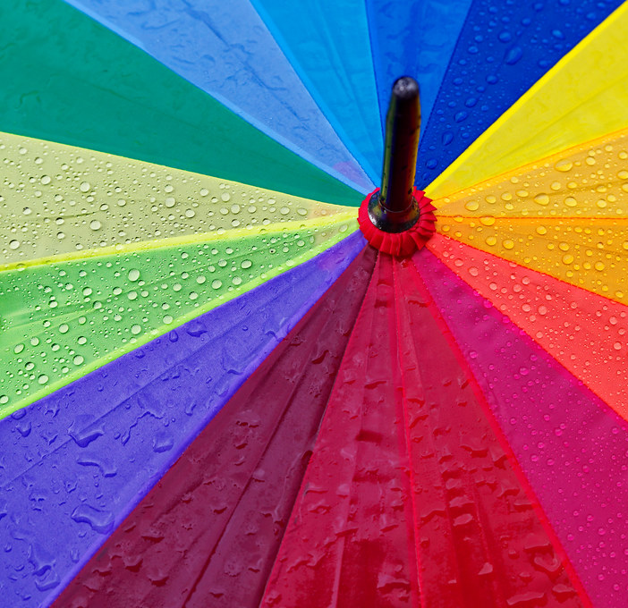
An introduction to
Diversity, Equity & Inclusion (DEI)

Slide 2








To make the most of our time together…
Demonstrate respect for different views
Silence your phone
Actively listen to understand
Avoid checking email and taking calls
Assume positive intent
Stop us when something isn’t clear and ask questions
Maintain confidentiality
Notes:
Explaining code of conduct?
-> guideline for communication?

Slide 3
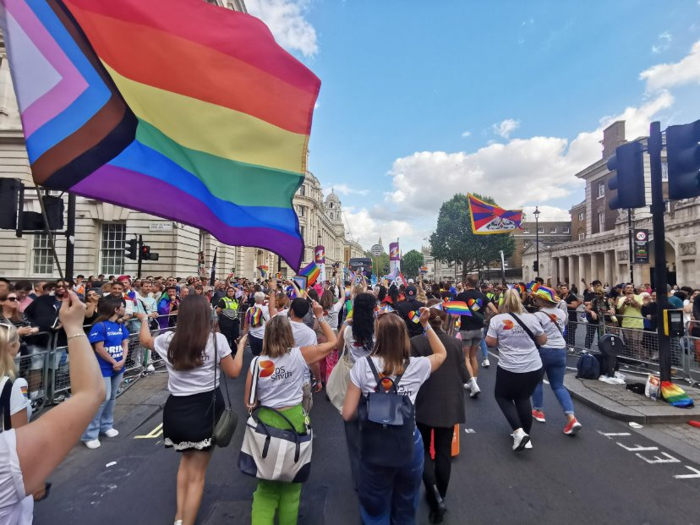
Agenda
What is DEI?
  Zoom in on Diversity
  Zoom in on Equity
  Zoom in on Inclusion
Why is DEI important?
DEI whiteboard exercise

Slide 4
What is DEI?
DEI stands for Diversity, Equity and Inclusion.
DEI helps us:
Respect each other
Have the courage to challenge the status quo
Make positive changes
Feel safer and empowered to be ourselves
DEI is important because we can only make an impact when we feel seen, heard and appreciated.
-University of Twente-

Slide 5
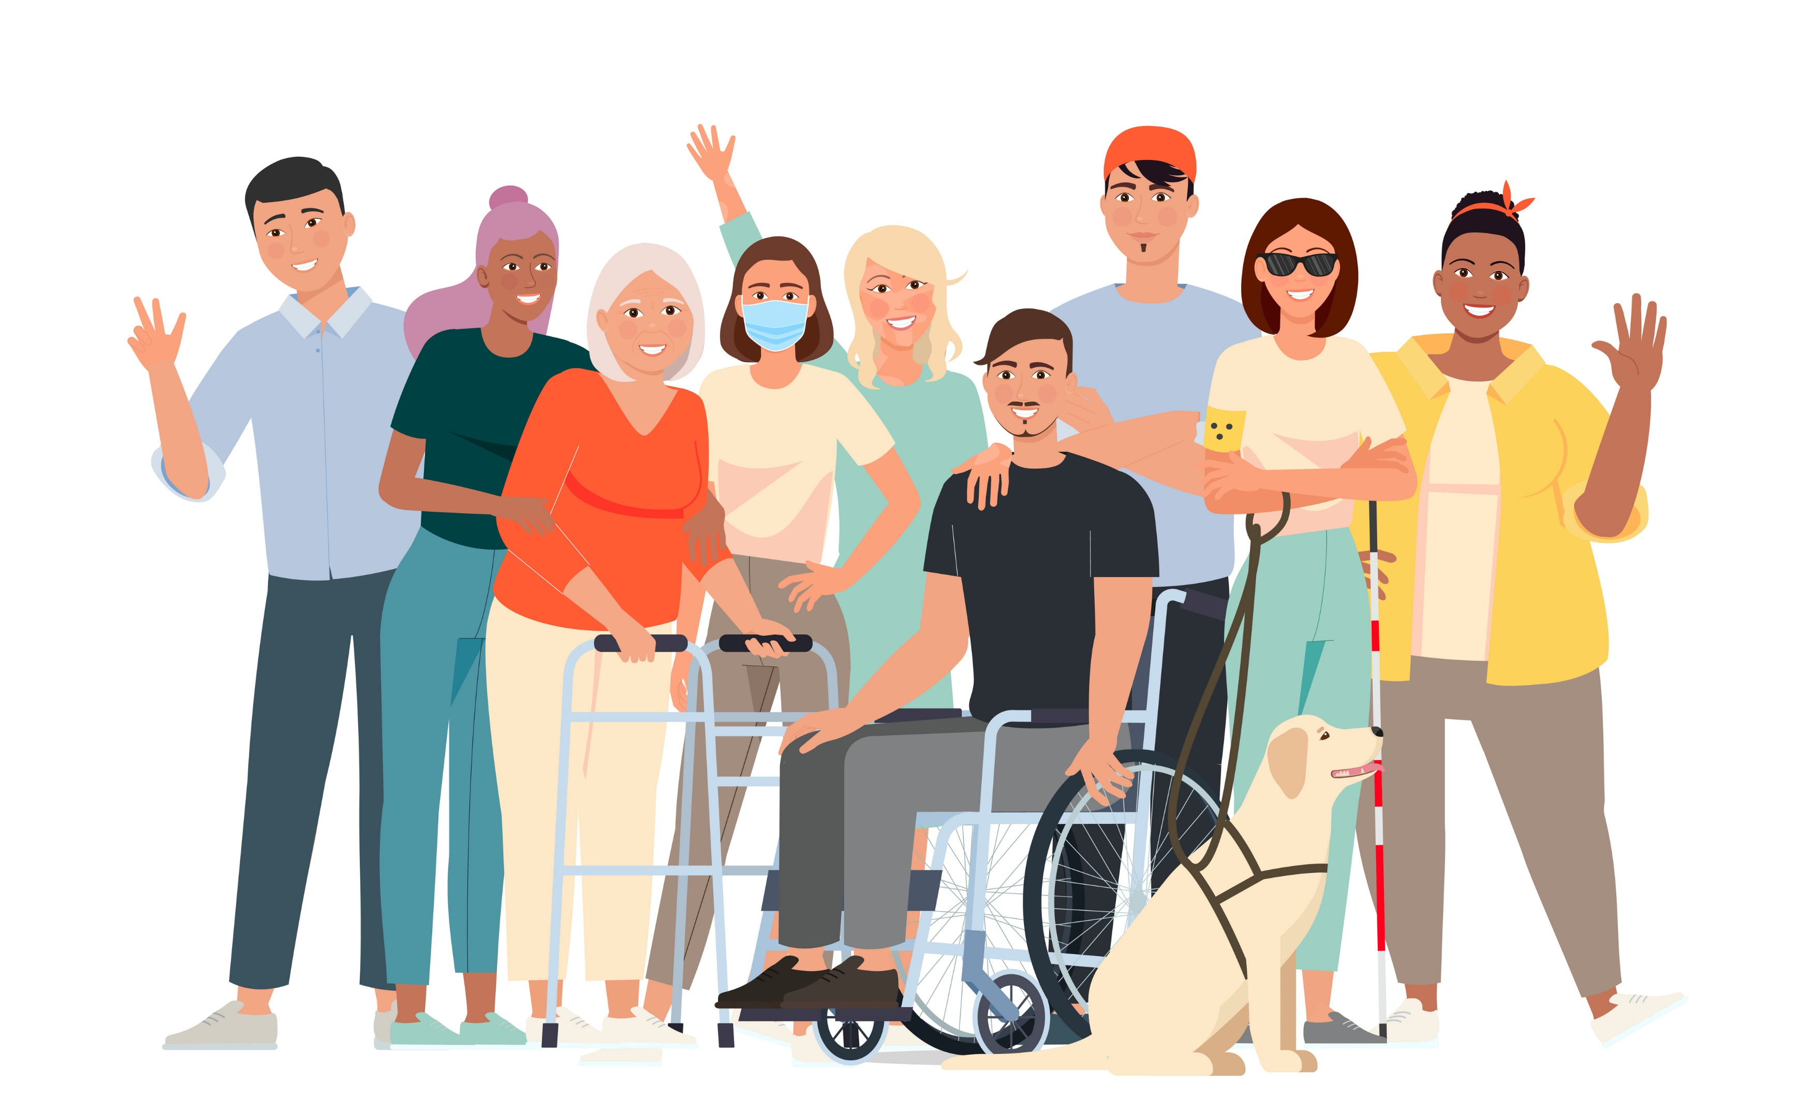
Icebreaker
Can you share…
Who are you? (3 words that best identify you)
A time you felt you could be yourself at work
Notes:
Facilitator begins discussion by sharing characteristics about themself (e.g. Mother, Operations Director, Wife, etc.)

Slide 6
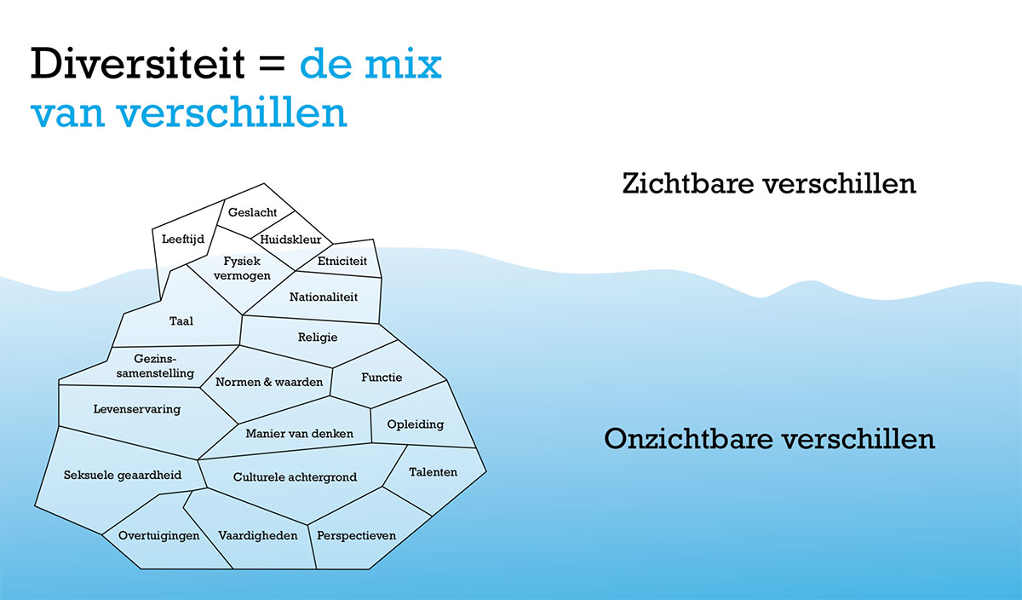
Diversity
Diversity refers to the differences between people.
Diversity is not just what you see. There there can also be invisible differences:
  Sexuality
  Religion
  Cultural differences
  Different ways of processing information
  Life experiences
Diversity has many benefits – can you give us some examples?
Notes:
Diversity includes but is not limited to, race, ethnicity, gender, gender identity, sexual orientation, age, social class, physical or mental ability, religious or ethical values system, national origin, and political beliefs. It also includes diverse thinking and neurodiversity.

Slide 7
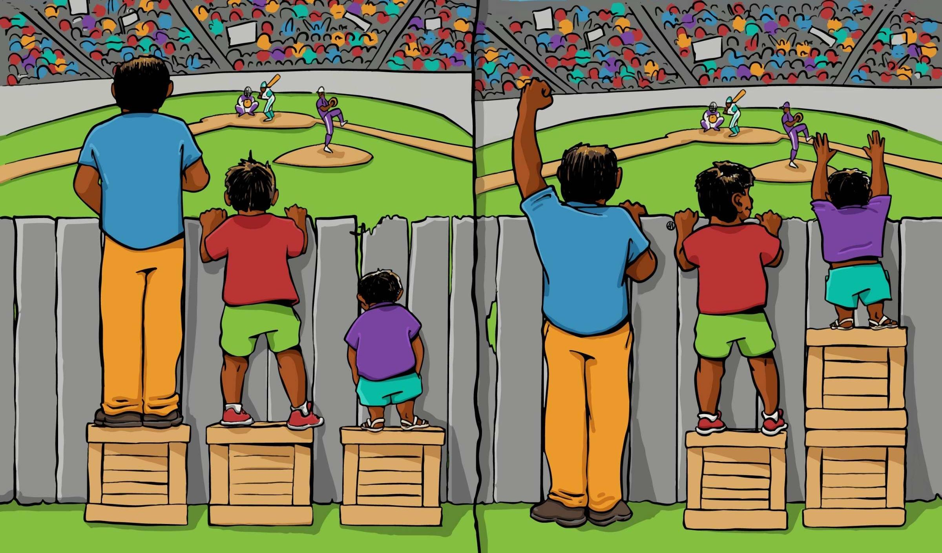
Equity
Not everyone starts at the same point in life.
Equity is about recognising people have different needs and accomodating people’s different needs.
Examples include:
  Personalised development paths
  Lowering a work station for a wheelchair user to access the necessary materials for their job
  Allocating resources in schools based on students’ specific needs
How are these pictures different?

Slide 8
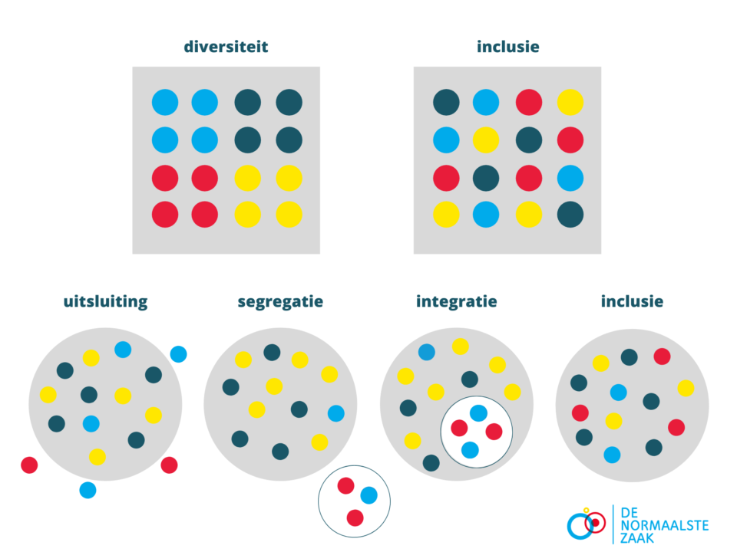
Inclusion
Inclusion is the active involvement of all individuals in a group whilst taking into account the differences that exist.
When there is inclusion, everyone should feel comfortable expressing themselves and feel respected, heard and valued.
How will you help create a culture of inclusion?
Notes:
You can achieve inclusion through commitment, courage, bias awareness, curiousity, educating yourself on different cultures and working together to understand each other.

Slide 9
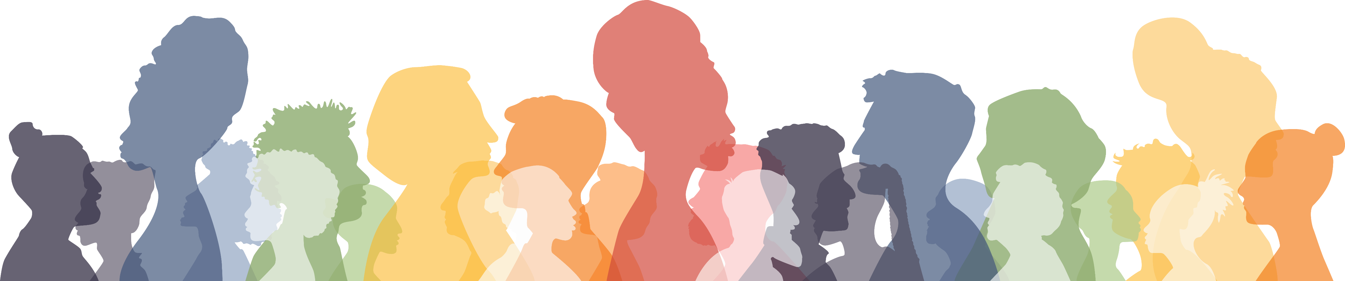
Why is DEI important?
So many reasons, and here are some examples ☺
Diversity leads to creative solutions and innovation
Equity involves giving people opportunities and access to resources to enable them to thrive
Inclusion creates a supportive atmosphere at work so everyone can reach their full potential

Slide 10
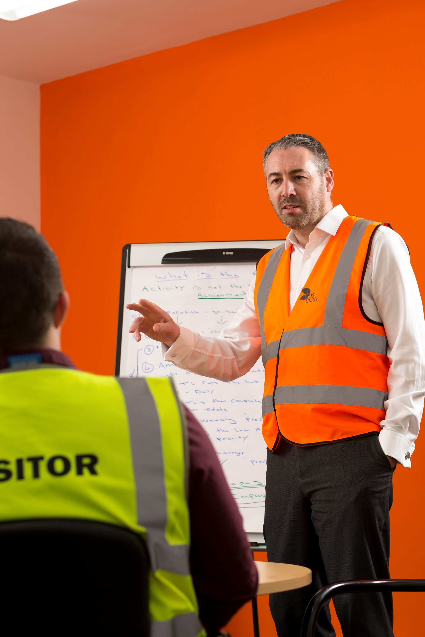
DEI whiteboard exercise
Each group will get a card with a scenario and are encouraged to brainstorm the actions they would take to be more inclusive:
  A colleague does not speak Dutch as a first language and says they struggle to understand when people speak too quickly
  A few colleagues have shared they are fasting for religious and/or cultural reasons
  A colleague has just returned from maternity leave and mentions that so much has changed since they were previously at work
  It’s an apprentice’s first week on the site and they say they are confused and need support
Notes:
Facilitator can encourage each group to share their story with the wider group, and then prompt people to reflect on the activity at the end

Slide 11
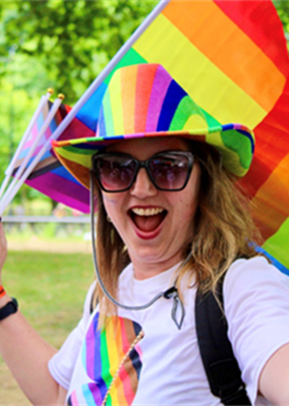
Other ways to celebrate diversity:
Celebrate different religious holidays – for example: Easter, Christmas, Eid, Holi & Diwali
Celebrate awareness days – for example: Black History Month, World Mental Health Day, Pride Month
Reach out to a Trust person (Benelux)
Speak up! If you see injustice. For yourself and for others. You can do this in person, through HR, through your manager or use the confidential hotline.
Organise a group meal where people can bring different cultural foods (a literal celebration!)
In accordance with or in collaboration with HR and/or the active networks, organise an informative session on a diversity – whether this is religious, cultural or mental health related
Notes:
Encourage the group to get creative with how they celebrate…
Remove Trust person bullet point if not relevant to your country/site

Slide 12

Our aim: make DS Smith a more inclusive place to work
What one thing will you do differently after the workshop?
Notes:
We all have a role to play in fostering an inclusive workplace.

Slide 13

Our Active Networks
Provide a safe space
Offers a platform to openly discuss experiences and perspectives
Building wellness through greater empathy, understanding and allyship
If someone here is interested in joining an active network, please let HR know, we can set up a session in a meeting room.
You can dial in via your personal phone or set up a watching session to join in for the monthly calls hosted by the networks (in English)
Notes:
The networks hope to provide discussion topics and create allyship by sharing educative materials at all levels of the organisation and create an even bigger network with DEI champions everywhere!

Slide 14
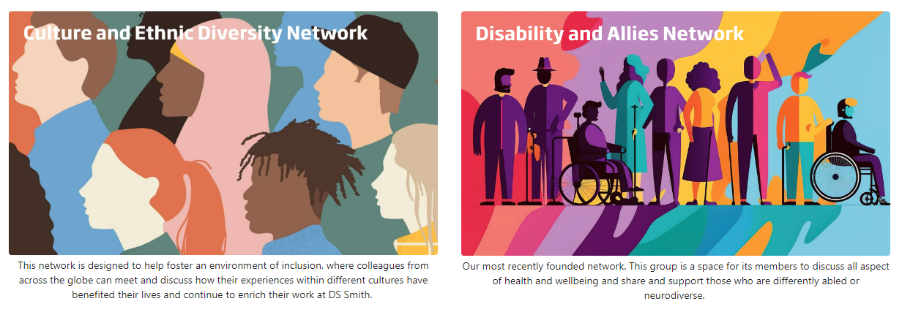
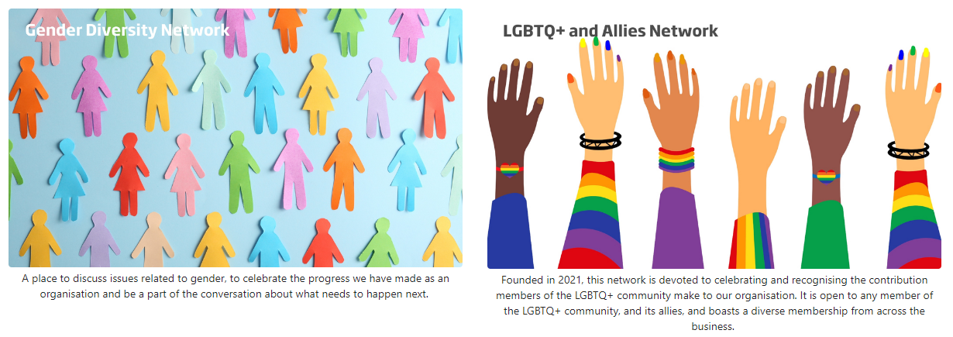
Our Active Networks
Notes:
Links to share joining the call:
Active Networks

Slide 15
An introduction to
Diversity, Equity & Inclusion (DEI)
Part 2

Slide 16
Agenda
Recap DEI
What is bias?
Conscious and unconscious bias
Effects of Bias
Notes:
Before starting please ask people what they remember about DE&I

Slide 17
DEI Recap
So many reasons, and here are some examples ☺
Diversity leads to creative solutions and innovation
Equity involves giving people opportunities and access to resources to enable them to thrive
Inclusion creates a supportive atmosphere at work so everyone can reach their full potential

Slide 18
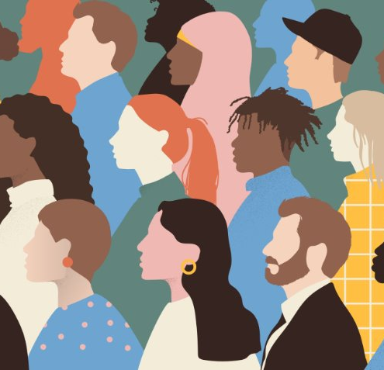
What is bias?
Bias is a preference or inclination towards one thing over another, often without considering all the available evidence or perspectives. We can have a bias towards products, goods but also people
It can influence our thoughts, decisions, and actions in ways we may not be fully aware of.
Bias can arise from personal experiences, cultural influences, stereotypes, or even unconscious processes.
It can affect how we perceive information, interact with others, and make judgments, sometimes leading to unfair or inaccurate conclusions.
Recognizing and addressing bias is important for making fair and informed choices.

Slide 19
What bias looks like?
Physical appearance
Age
Bias towards people looks like a preference/ avoidance for certain characteristics such as…
Ethnicity
Sexual Orientation
Gender
Religious beliefs
Notes:
Bias can f.e. be an outcome of experience, the common believe of a group or portrayal of certain groups in the media. Usually common bias is something we have based on how someone acts or looks.
Bias is not always a bad thing – sometimes it helps us protect ourselves from dangerous situations for example when someone is acting suspicious.

Slide 20
Conscious Bias vs Unconscious Bias
Bias is usually based on our experiences, our trauma, our deep seated thought patterns, the believes of our social groups and our assumptions.
Typically, we have a positive bias to our ingroup and a negative bias towards our outgroup.
Confirmation bias is when we feel justified in our believes because we surround ourselves with information that confirms our believes and others with the same believes
Concious Bias | Unconcious Bias
A judgment we are aware we have; | A judgment we are unaware we have;
For example: you sometimes feel disagreement when someone has a different religion from you. You are aware you feel this way. | For example: you sometimes exclude people with red hair from conversations, but you don’t notice that you do this.
Notes:
Unconscious bias however is when we are.. (continuation on last slide)

Slide 21
Effects of Bias:
Bias can lead to…
Exclusion
Discrimination
Stereotyping
But also..
Remaining safe
(if someone is holding a knife and walking towards you, you should listen to your bias and run!!)

Slide 22
Why Addressing Unconscious Bias Matters
Individuals
may experience…
Majority and Minority groups may experience…
People of color may experience…
Fear of being excluded from group activities.
Fear of being stereotyped for speaking out.
Resentment of the burden of educating the majority group.
Emotional exhaustion from being constantly
“on guard”.
Compromised well-being.
Lowered productivity.
Fear of saying the wrong thing and being penalized for it.
Diversity fatigue.
Helplessness to make positive change.
Sources: Catalyst. What Is Covering? New York: Catalyst, December 11, 2014. Dnika J. Travis and Jennifer Thorpe-Moscon, Day-to-Day Experiences of Emotional Tax Among Women and Men of Color in the Workplace (Catalyst, 2018). Jennifer Thorpe-Moscon, Alixandra Pollack, and Olufemi Olu-Lafe, Empowering Workplaces Combat Emotional Tax for People of Colour in Canada (Catalyst, 2019).

Slide 23
Session review
What were your thoughts on todays session?
Do you think you will recognise bias from now on?
What will you take away from todays session?

Slide 24
An introduction to
Diversity, Equity & Inclusion (DEI)
Privilege pack
Notes:
Up to own discretion to use these slides

Slide 25
BE AWARE
You can add this part into your training only in agreement with the subregional HR director.
The group DEI team discourages any site from adding this part of the training due to the topic sensitivity.

Slide 26
DEI Recap
So many reasons, and here are some examples ☺
Diversity leads to creative solutions and innovation
Equity involves giving people opportunities and access to resources to enable them to thrive
Inclusion creates a supportive atmosphere at work so everyone can reach their full potential

Slide 27
Privilege walk Exercise
Notes:
Refer to privilege walk exercise

Slide 28
Exercise review
What did you learn from the exercise?
Were you surprised by the outcome?
How did you feel about your final landing position?
What might we draw from this exercise in our day-to-day life?

Slide 29
Privilege walk Video
Notes:
Refer to privilege walk exercise

Slide 30
Reflections
Any thoughts, reflections, or comments following the video?
Notes:
Facilitator ends with sentiment, we don’t necessarily know what is going on in people’s lives, or their experiences, so that is why it is important to treat each other with respect.

Slide 31
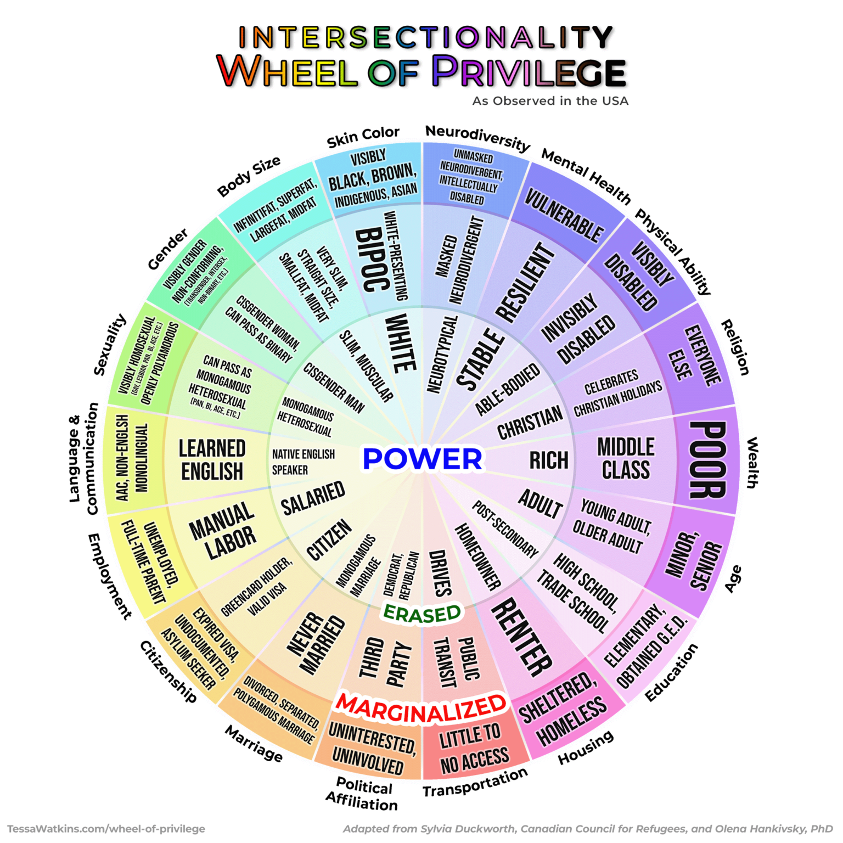
Privilege
Privilege is ‘when one group has something of value that is denied to others simply because of the groups that they don’t belong to’ – McIntosh
Privilege gives us an advantage that could potentially work in our favour. Examples are: it could be easier to get a job because of your name, it might be easier to get promoted because of your gender or you might get time off on the religious holidays relevant to your faith.
privilege is a fact, not an insult.

Slide 32
Privilege
There is unearned and earned privilege, with unearned privilege being more prominent
Many of us experience a combination of privilege and disadvantages; f.e. a white (privilege) female (disadvantage), or disabled (disadvantage) male (privilege); this is called intersectionallity
Unearned privilege | Earned privilege
Sexual orientation | Class
Class | Education
Religion | Seniority in an Organisation
Gender
Parents education

Slide 33
Session reflection
What are your thoughts on today’s session?
Was it difficult to participate in the exercise and how did you feel about what your landing position was?
Anything else you would like to share with the group?

Slide 34
Racism & Microaggression
Jeel Desai, Mattie Keessen & Jessica Heap
By the Culture and Ethnic Diversity Network

Slide 35





Activity
On a scale of 0-5, how comfortable are you talking about race?
On a scale of 0-5, how comfortable are you talking about racism?
I am very uncomfortable talking about race/racism.
I am usually uncomfortable talking about race/racism.
I am sometimes uncomfortable talking about race/racism.
I am usually comfortable
talking about race/racism.
I am very comfortable
talking about race/racism.

Slide 36
Key Terms
Feeling
Prejudice
“Pre-Judge”
Behaviour
Discrimination
Action
Idea
Stereotype
“Prototype”
Preference
Bias
Bias – a preference for or against a person, idea or thing
Stereotypes – are over-generalised and over-simplified ideas & assumptions about people because of one part of their identity e.g., their race, sexuality, age, religion, gender etc. Stereotypes can be positive or negative.
Prejudice – is the formation of negative feelings, attitudes or opinions towards an individual(s) based solely on their membership to a particular social group.
Discrimination – is negative, destructive and/or exclusionary behaviour and action against an individual based solely on their membership to a particular social group
Notes:
Speaker Notes:
Often people can use the terms prejudice, discrimination, racism and stereotyping interchangeably, as though they all mean the same thing. Taking the time to understand the differences between these terms will allow us to treat all people with the respect and dignity they deserve.
Stereotypes are
Prejudice , simply put, is to pre-judge someone before you get to know them.
Overgeneralised beliefs about people may lead to prejudice. Feelings may influence the treatment of others, leading to discrimination. Holding stereotypes and harbouring prejudice may lead to excluding, avoiding and biased treatment of group members.
Bias – a preference for or against a person, idea or thing
Prejudice – is judging or forming an opinion before having all the relevant facts
Stereotype – an over-simplified idea or assumption applied to all members
Stereotypes can be maintained by biases

Slide 37
Key Terms with Examples
Item | Function | Definition | Example
Stereotype | Cognitive – your thoughts and ideas about people | Assuming that because a group of people share some of the same characteristics that they also share the same attributes. | People with Pink Hair are arrogant and obnoxious
Prejudice | Affective – your feelings about people | When someone has a belief or feeling (usually negative) about a person or group based on a stereotype. | I don’t like people with Pink Hair
Discrimination | Behaviour – your actions towards people | When someone acts on their prejudiced beliefs. | I am not going to be friends with anyone with Pink Hair

Slide 38
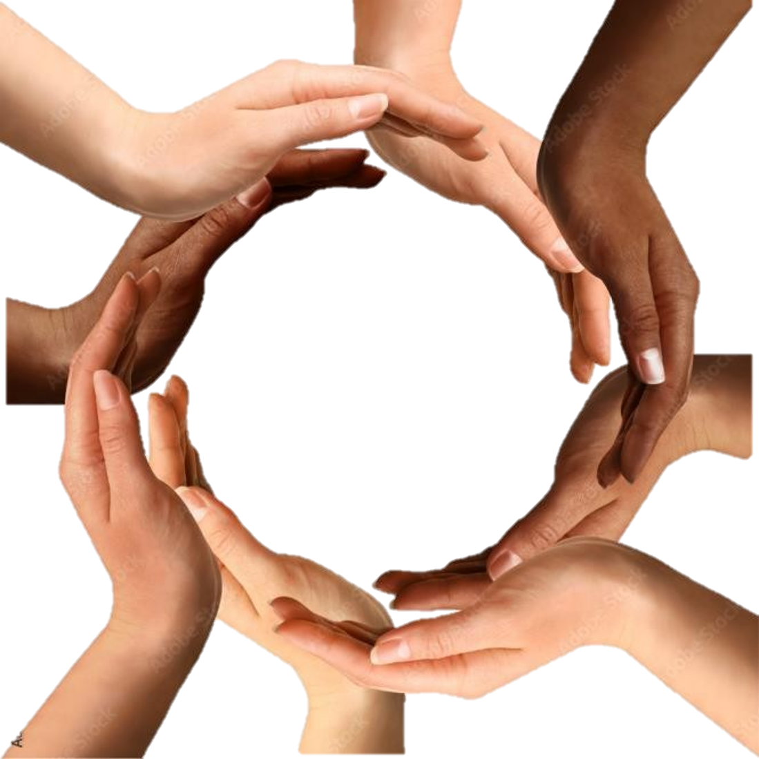
Definitions
Culture: Defines the sets of thoughts, beliefs, values & customs of people living in a certain area (geographically defined).
Ethnicity: This refers to those you have a common ancestry, language and/or culture
Race: A group of people who have a similar appearance.
Culture, Ethnicity & Race
Notes:
Speaker Notes:
We sometimes use the words Culture, Race & Ethnicity interchangeably and whilst there is some overlap between the words, its important to know the differences between them and to use them correctly.
Culture: These are learned behaviours – thoughts, beliefs, values and customs – that you pick up as you grow up and choose to adopt or leave behind as you get older. You can have cultural elements and influences from various places, and in general, it’s your choice.

Slide 39
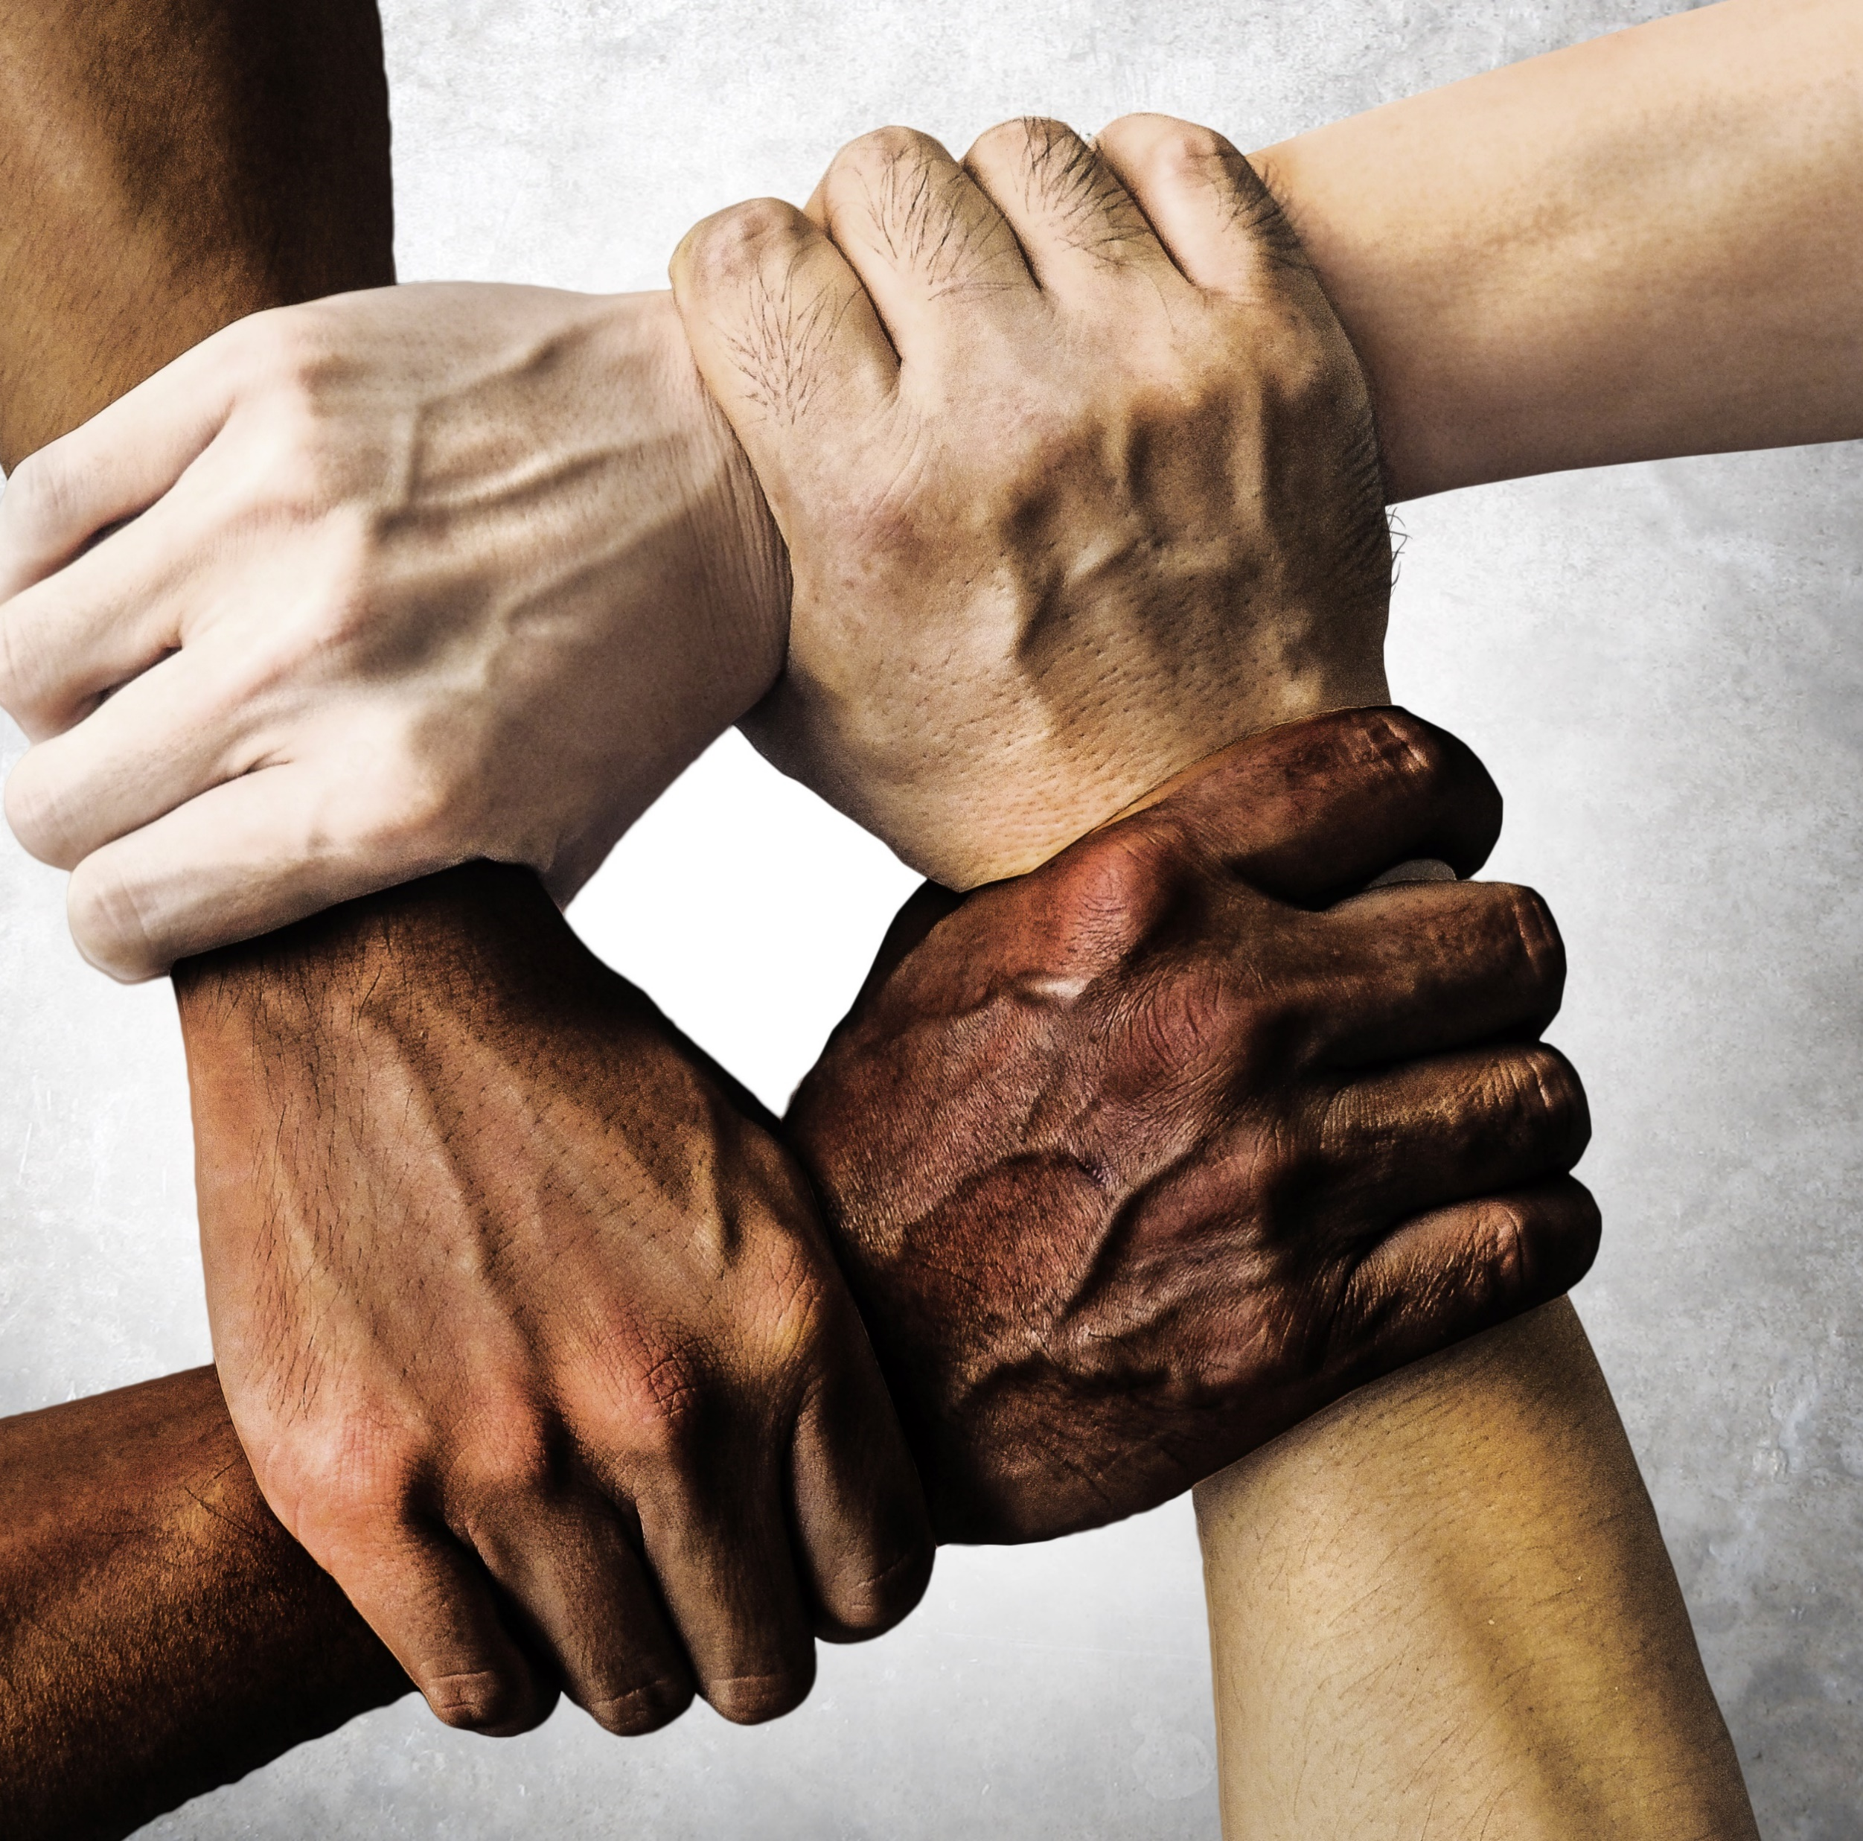
Discrimination related to Culture, Race & Ethnicity
Racism
negative, destructive and/or exclusionary behaviour and action against an individual based solely on their race
Xenophobia
Negative behavior towards individuals from other countries
Nativism
A policy of favoring native inhabitants as opposed to immigrants
Notes:
Racism / Xenophobia may express itself in the following ways:
Hate crime
People screaming on the street (racial slurs and hate speech)
People spitting on someone
Bullying
Stereotyping
Microaggressions

Slide 40
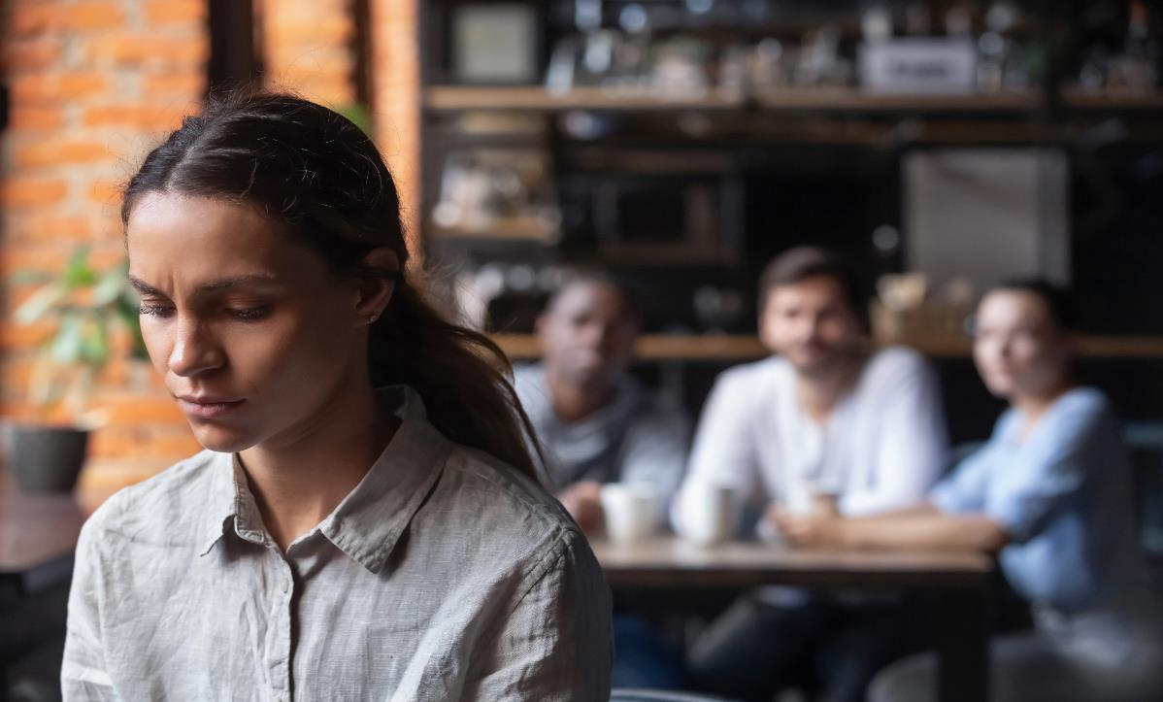
What is a Microaggression?
Microaggressions are the everyday verbal, nonverbal, and environmental slights, snubs, or insults, whether intentional or unintentional, which communicate hostile, derogatory, or negative messages to target persons based solely upon their marginalized group membership.
Notes:
Speaker Notes
Micro-aggressions have often been described as many small paper cuts
Its there cumiliative effect over time that can be large
Microaggressions are everyday slights or insults that can seem small or subtle but can be very hurtful in that they convey negative underlying messages based on a marginalised group identity and they occur.
May pertain to race, gender, sexual orientation, class, disability or age and be derogatory or hostile in nature. Sometimes they are made consciously but often they are unconscious to the person speaking.
The speaker may even think they are giving a compliment, when in fact there is a hidden insult or negative assumption underneath. We can have a good intentions, but our words or actions can have a negative impact that doesn’t match our intent. Regardless of our intentions, we have to take accountability for the impact of our actions and words on others. .
Can you think of any toxic employees? How long have they been here? What impact have they had on morale?

Slide 41
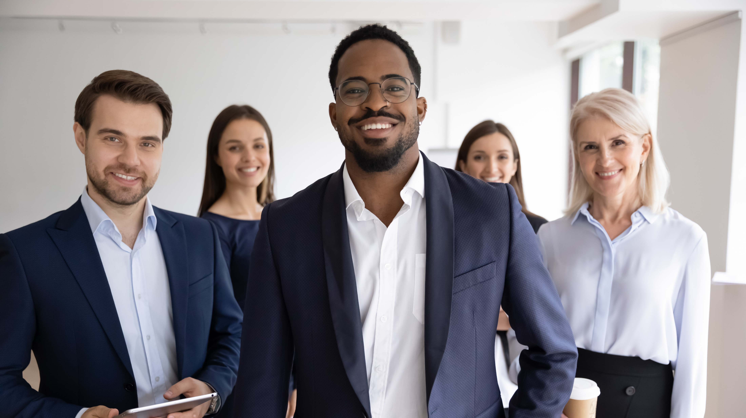
How to recognise Microaggressions
Steps you can take to improve your ability to recognise microaggressions:
Educate yourself on the different types of microaggressions through research
Recognise your own biases and prejudices
Pay attention to subtle comments or actions that make others feel uncomfortable, undermined, or stereotyped
Be aware of instances where individuals are singled out based on their identity or background
Examples of Microaggressions:
Telling someone they should book an earlier flight because they spent a long time at border control because they have a different passport
Unintentionally saying that a POC person can speak “great English”
Continuously mispronounced a person’s name because “it is too hard” to say correctly
Can you think of any others?
Notes:
Can you think of any other examples?
The biggest difference between microaggressions and overt discrimination is that people who commit microaggressions might not even be aware of them

Slide 42
Examples of Microagression
Telling someone they should book an earlier flight because they spent a long time at border control because they have a different passport
Rejecting someone from a job application because their name is different
Questioning if someone belongs in a certain place because they are of a darker skin tone
Unintentionally saying that a POC person can speak “great english”
Continuously mispronounced a person’s name because “it is too hard” to say correctly

Slide 43
Addressing Microaggressions
With the person responsible
Listen, empathize and validate concerns
Act to make things better and more inclusive
Hold yourself and others accountable
Be consistent in your support
Be a role model for others
With the person impacted
Acknowledge the incident privately
Use patient language – recognize everyone makes mistakes
Explore their intentions
Educate them on the impact
Encourage them to reflect on their actions
Establish healthy boundaries
Evaluate alternatives

Slide 44
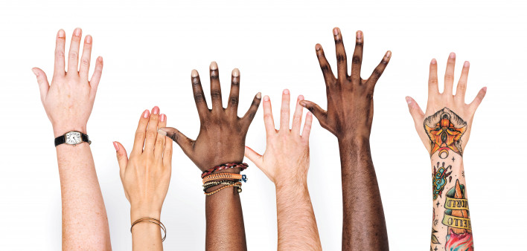
Impact of Discrimination
Discrimination can lead to:
Isolation & Exclusion
Feelings of sadness and lack of trust
Reduced self-confidence and self-worth
Anxiety / Fear of being attacked physically or verbally
What do you think the Impact of Discrimination is?
Notes:
What do you think the impact of Microaggressions / Discrimination are?

Slide 45

Session review
On a scale of 1-5, how comfortable do you feel about talking about Race/Racism now?
What one word describes how you feel after this session?
What one thing will you do differently after attending today's session?

Slide 46
Hidden Disabilities
By the Disabilities and Allies Network

Slide 47
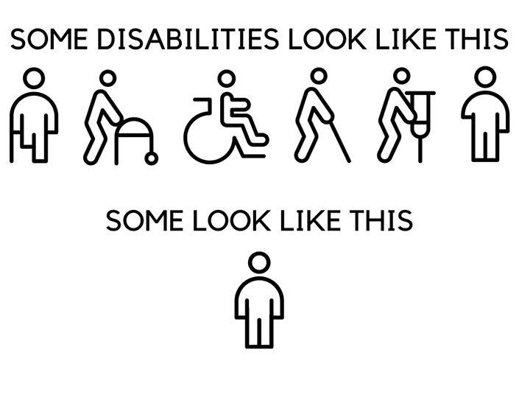
What are some hidden disabilities?

Slide 48
Agenda
Hidden disabilities
Zoom-in on Neurodiversity
Zoom-in on Mental Health

Slide 49
What is classed as a Hidden Disability
Coeliac Disease
Scleroderma
Ulcerative Colitis
ADHD / Autism
Myalgic Encephalopathy/Chronic Fatigue Syndrome (ME/CFS)
Lupus
COPD
Dyslexia
Asthma
Crohn’s Disease
Aphasia
Migraine
Diabetes Type 1 & 2
Dysautonomia
Functional Neurological Disorders (FND)
Alzheimer’s
Endometriosis
Epilepsy
Haemophilia
Ehlers-Danlos Syndrome (EDS)
Parkinson’s
Long Covid
Narcolepsy
Multiple Sclerosis
Foetal Alcohol Spectrum Disorder (FASD)
Tourette Syndrome
Peri/menopause
Stuttering
PoTs (Postural Tachycardia Syndrome)

Slide 50
Hidden disabilities
A hidden disability is a physical, mental, or neurological condition that is not visible from the outside, yet can limit or challenge a person’s movements, senses, or activities.
With a hidden disability, most people around you cannot see/understand, this can get lonely.
Some Hidden disabilities:
  Autoimmune diseases: Diabetes, IBS or Ulcerative Colitis
  Chronic diseases: Cancer, Alzheimer or Heart Disease
  Neurodivergence: ADHD, Autism or OCD
  Allergies
  Arthritis
  Mental health illness (sometimes officially classed)

Slide 51
Microaggression for Hidden disabilities can look like..
But you don’t look sick?
But you’re so young!
I’m totally OCD/PTSD about that too
You can’t park here you’re not in a wheel-chair
You’re an inspiration. I could never deal with that.
It’s not THAT bad
Show me where it hurts
Must be nice to sit at home all day!
You must just not want to be friends with me, you always ignore me/just stay home
Notes:
The facilitator notes can ask the group why these sort of statements are not appropriate.

Slide 52
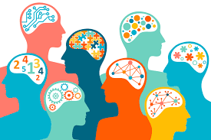
What do you think of when you hear “Neurodiversity”?
Shout!
Notes:
Trying to gauge the audience, what words they use….

Slide 53
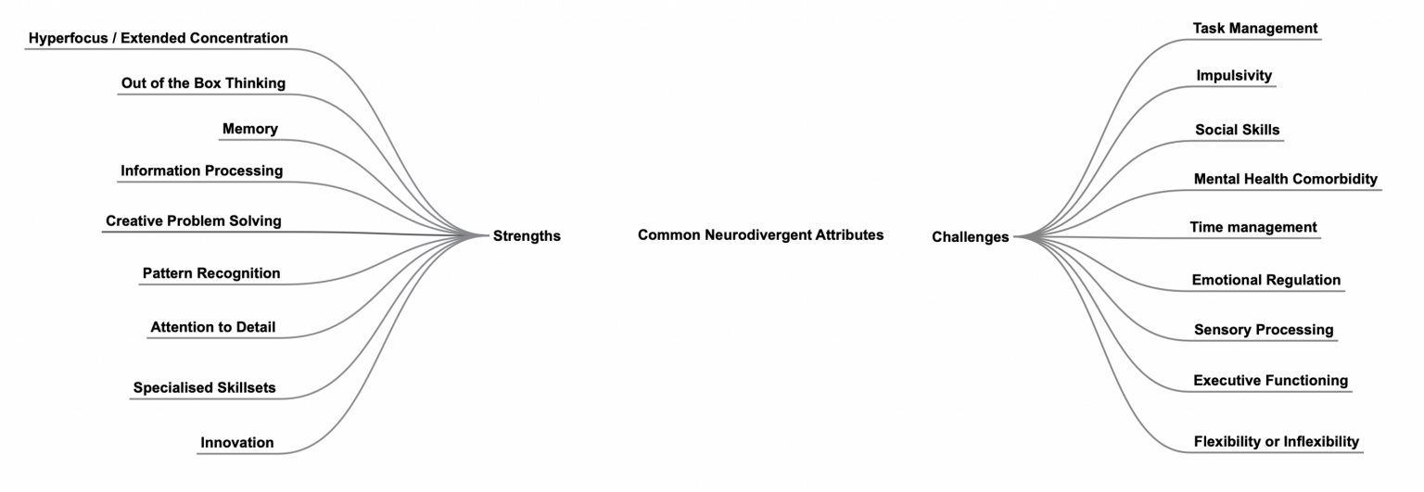
Neurodiversity
Neurotypical refers to someone whose thoughts, feelings, needs, and abilities align with ‘typical’ ways of functioning.
Neurodivergent refers to someone who does not fit neurotypical standards and might have different support needs.
Neurodivergent people are known to be better than others at pattern recognition, analysis, mathematics and out-of-the-box thinking
15 to 20% of the world is neurodivergent

Slide 54
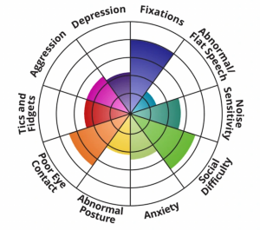
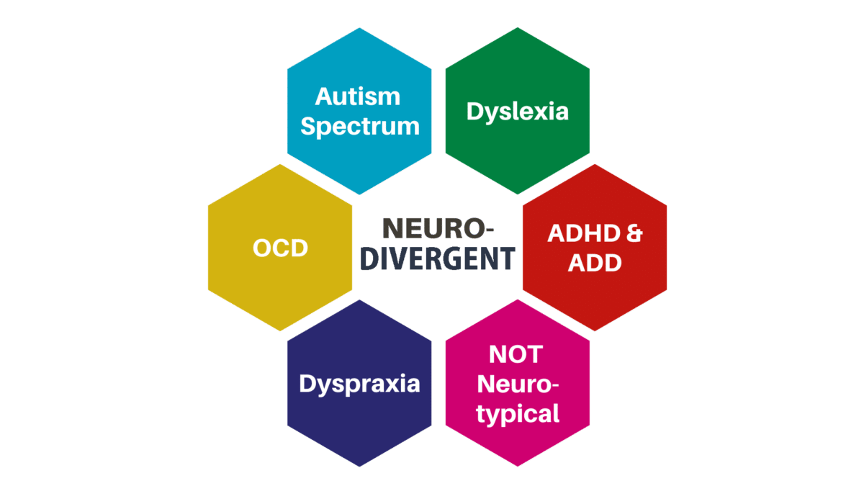
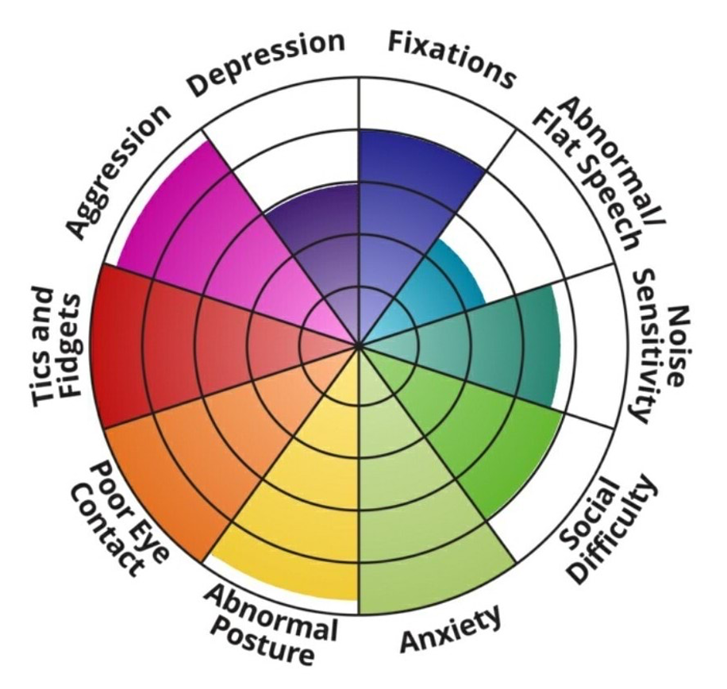
Neurodiversity
Spectrum of neurodiversity:
Examples of Neurodiversity:
Notes:
Maybe ask if anyone notices something about the language in the pictures on the right?
Show next picture: what do you notice differently about the language in this picture?

Slide 55
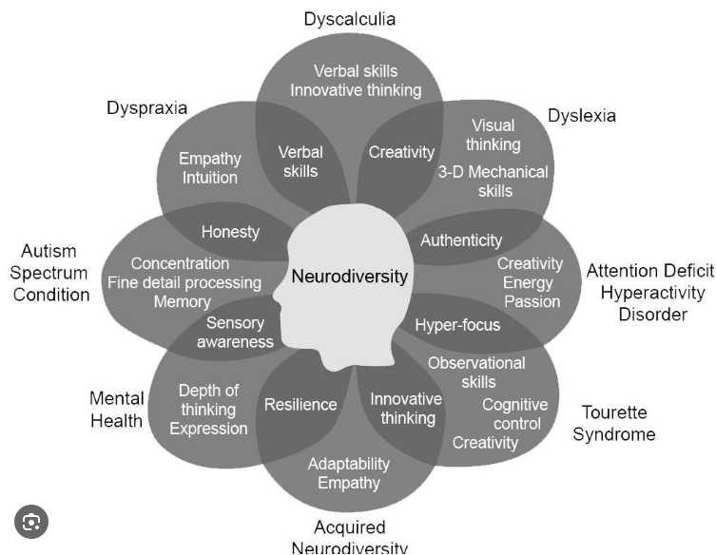
Changing Language to be inclusive…
Notes:
Do you recognise a difference between the language used in this slide and the previous one?

Slide 56
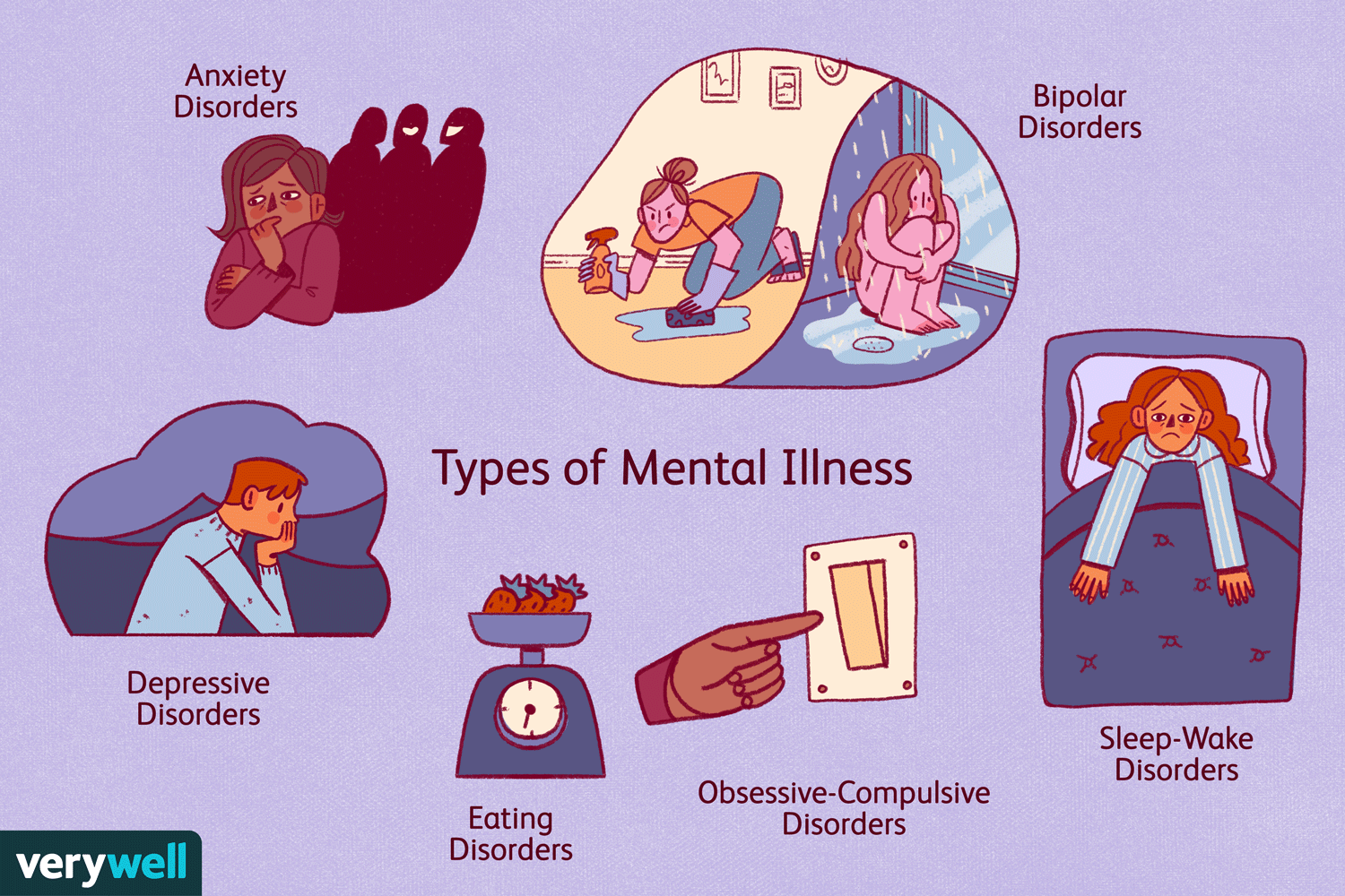
Mental health
Mental Health problems can be a hidden disability and can sometimes lead to neurodivergency
Most mental health illnesses can be categorized into one of the following:
  Anxiety disorders, Bipolar disorders, Depressive disorders, Eating disorders, Obsessive-compulsive disorders, Sleep-Wake disorders
¼ the of the European population suffers from a mental health illness at least once in their life.
Just like Neurodiversity, mental health illness exists on a spectrum.
Mental health problems look different in everyone; there can be physical effects

Slide 57
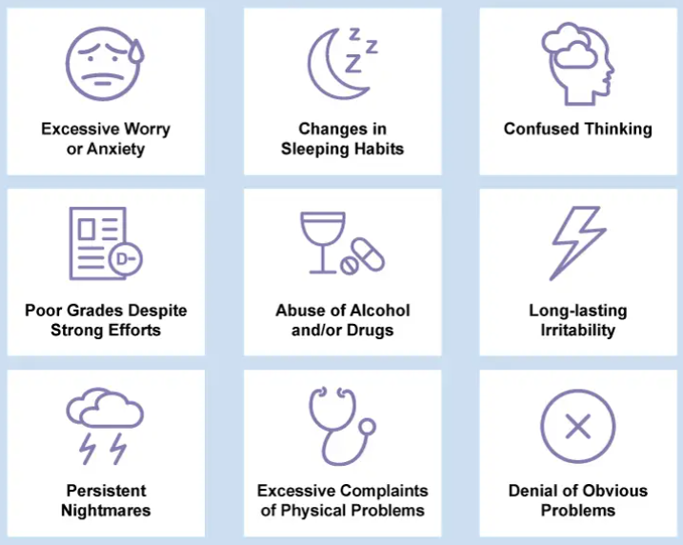
Mental Health Illness is common.
It is not something to be embarrassed about
you do not have to go through something extreme to get a mental health illness
Mental health illness looks different in everyone; on the left are some examples
Please reach out to your GP, HR, friends or family if you think you might have a mental health illness

Slide 58
Session review
What did you learn from this workshop?
What do you wish more people knew about hidden disabilities?
Any other reflections?

Slide 59
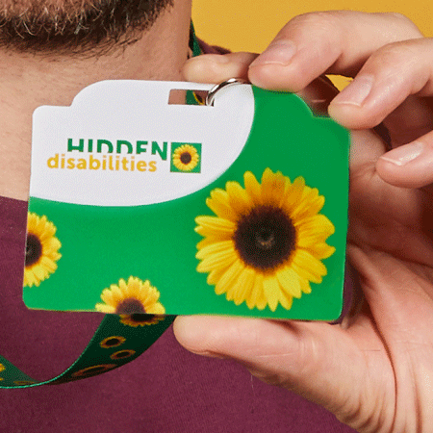
The Sunflower…
The Sunflower is connected to you all around the world
The Sunflower is there for you as you work, shop, travel, learn and at leisure.
Businesses all around the world have joined the global Sunflower network to support you when you wear the Sunflower - anywhere you choose to be discreetly seen.
Notes:
Only use in available countries; check google if available in your country

Slide 60
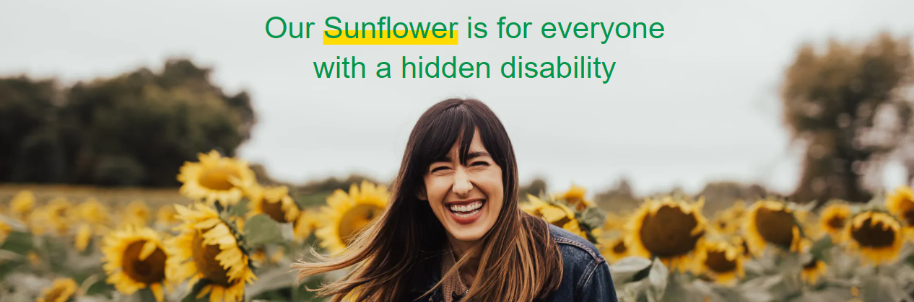
What is the Hidden Disabilities Sunflower?
The Hidden Disabilities Sunflower is a simple tool for you to voluntarily share that you have a disability or condition that may not be immediately apparent – and that you may need a helping hand, understanding, or more time in shops, at work, on transport, or in public spaces.
Some disabilities, conditions or chronic illnesses are not immediately obvious to others. For some people, this can make it hard to understand and believe that someone, with a “non-visible” condition genuinely needs support. Some people question whether you have a disability because you “don’t look like you have a disability".

Slide 61
LGBTQ+ & Allies Network

Slide 62
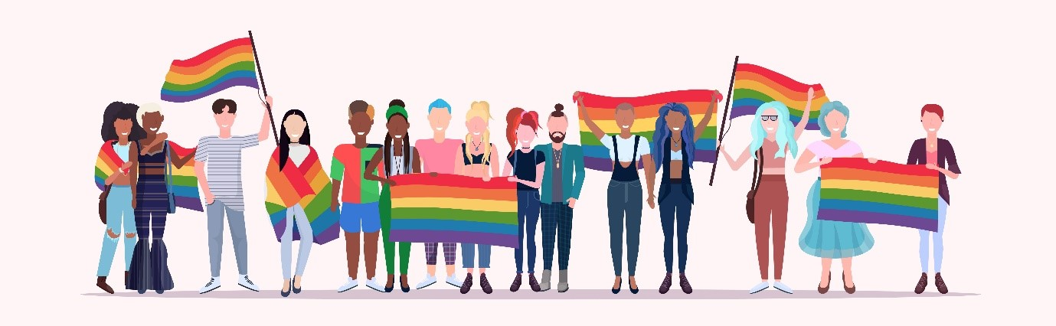
What does LGBTQ+ Stand for?
Lesbian -Refers to a woman who has a romantic and/or sexual orientation towards women.
Gay - Refers to a man who has a romantic and/or sexual orientation towards men. Also a generic term for lesbian and gay sexuality.
Bisexual - An umbrella term used to describe a romantic and/or sexual orientation towards more than one gender.
Trans - An umbrella term to describe people whose gender is not the same as, or does not sit comfortably with, the sex they were assigned at birth.
Queer - A term used by those wanting to reject specific labels of romantic orientation, sexual orientation and/or gender identity.
+ - This is used to reference all other terms that aren’t included in the acronym, such as intersex and non-binary.
Allies - A (typically) straight and/or cis person who supports members of the LGBT community.

Slide 63
What does LGBTQ+ Stand for?
Lesbian -Refers to a woman who has a romantic and/or sexual orientation towards women.
Gay - Refers to a man who has a romantic and/or sexual orientation towards men. Also a generic term for lesbian and gay sexuality.
Bisexual - An umbrella term used to describe a romantic and/or sexual orientation towards more than one gender.
Trans - An umbrella term to describe people whose gender is not the same as, or does not sit comfortably with, the sex they were assigned at birth.
Queer - A term used by those wanting to reject specific labels of romantic orientation, sexual orientation and/or gender identity.
+ - This is used to reference all other terms that aren’t included in the acronym, such as intersex and non-binary.
Allies - A (typically) straight and/or cis person who supports members of the LGBT community.
LGBTQ+

Slide 64
Important terminology to the LGBTQ+ group
Sex
Did you know that non-Western third genders exist?
Refers to a person's biological status and is typically assigned at birth, usually based on external anatomy.
Sex is typically categorized as male, female or intersex.
Gender
Often defined as a social construct of norms, behaviours and roles that varies between societies and over time. Gender is often categorized as man, woman or nonbinary.

Slide 65
Third Genders in non-Western cultures
Sekrata - Madagascar
Two-Spirit – Indigenous N. America
The Sakalava people recognize a third gender called Sekrata. Boys in Sakalava communities who exhibit traditionally feminine behavior or personalities are raised by parents as girls from a young age.
Instead of labeling these boys as gay, they are seen as having a male body and identifying as a female.
Sexual preference is not a factor for the Sakalava and raising a child in this third gender is natural and accepted in the community’s social fabric.
Indigenous individuals who identified as Two-Spirit folks were seen as gifted and honoured in their community because they carried two spirits with them, both male and female.
They were often the healers, medicine people, and visionaries within their given community and they were foundational members of their culture.
Two-Spirit is an umbrella term and different Indigenous North American cultures can have different terms for it.

Slide 66
Gender Identity, Gender, and Sex
As seen in the previous examples, gender and sex assigned at birth do not always to correspond to gender identity (one's own internal sense of self and their gender). This is the case for transgender and non-binary people
Transgender
An adjective used to describe someone whose gender identity differs from the sex assigned at birth. A transgender man, for example, is someone who was listed as female at birth but whose gender identity is male.
Non-binary
A term that can be used by people who do not describe themselves or their genders as fitting into the categories of man or woman. A range of terms are used to refer to these experiences; nonbinary and genderqueer are among the terms that are sometimes used.

Slide 67
Discussion
What are some of the challenges transgender and non-binary people might face?

Slide 68
Using pronouns the right way
Pronouns are words we use to refer to people’s gender in conversation - for example, “he’”, “she” , or “they”.
They/them pronouns are typically used by non-binary people.
Using the right pronouns for people is a powerful sign of acceptance and respect, making sure people feel SEEN. It promotes psychological safety, an inclusive environment, and it will identify you as an ally.

Slide 69
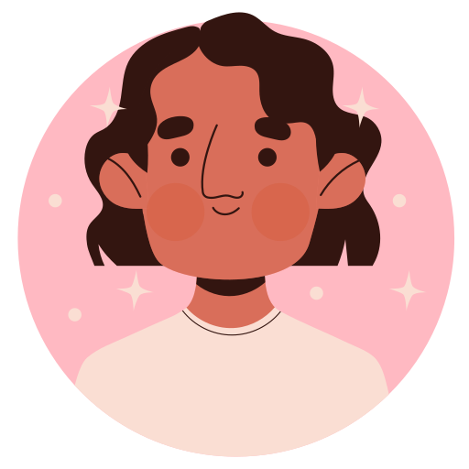
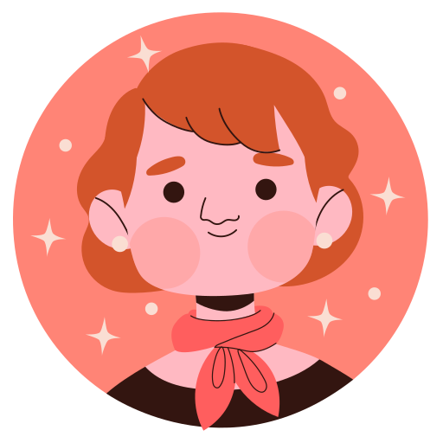
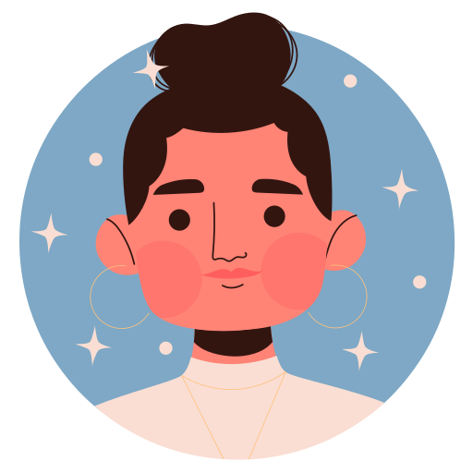
How to be an Ally
When you meet new people, introduce your name and pronouns
Add pronouns to your social media profiles and email signatures
If you don’t know the person’s pronouns, try to use they/them or gender-neutral language

Slide 70
Non-Binary Pronouns in Europe
Find out more here
As some European languages are gender specific, it can be difficult to identify the right terminology or words to use. Duolingo have done some research and propose:
Language | Gender-Neutral Pronouns
English | they/them/themself ze/hir/hirself xe/xyr/xyrself ve/ves/veself ey/em/emself and many more! English has near-infinite neopronoun options
Spanish | elle
French | iel ∅l al
German | xier/xies/dier sier/sies/dier
Portuguese | elu
Italian | There is a movement to use the schwa letter, ə, in place of the vowel that signals gender in most words, as in "ləi"; or you can cut the end of the word so that it is genderless
Galician | eli elu
Catalan | elli

Slide 71
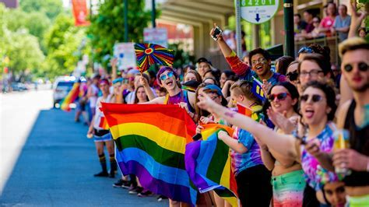
Other ways to be an ally – PRIDE!
Pride is celebrated around the world. It is usually a parade and other festivities and it is as much a celebration as a protest. It usually takes place in June but varies country to country.
The history of Pride began with the Stonewall riots, a series of riots for gay liberation that took place over several days beginning on June 28, 1969. The riots began after a police raid at the Stonewall Inn, a gay bar located within Lower Manhattan in New York City.
Following the Stonewall riots and the first pride marches, the number of LGBT groups rapidly increased

Slide 72
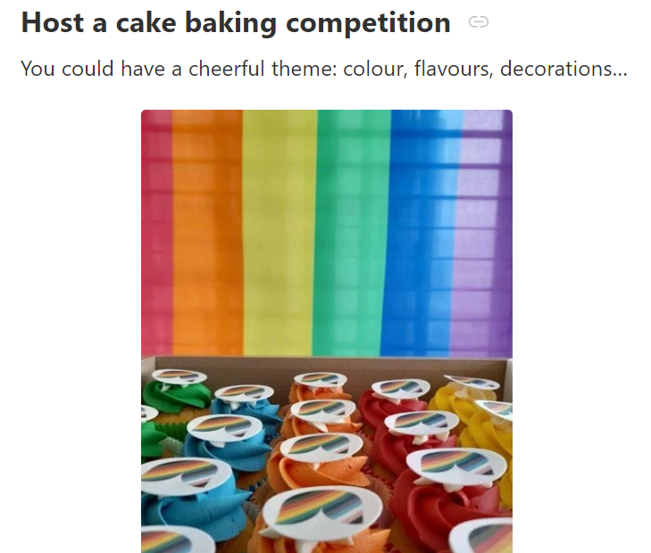
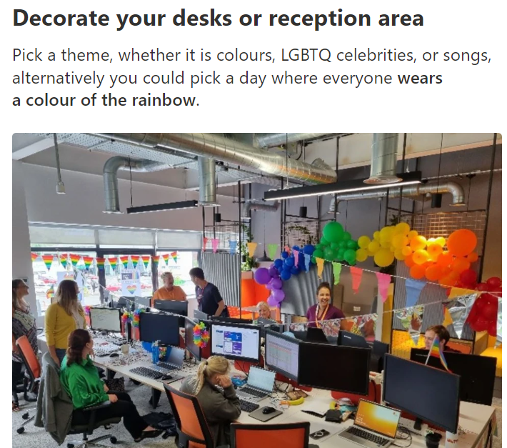
Pride at sites
Hosting a fun quiz
It could be around historical dates, characters, and celebrities is a way to help educate your colleagues and celebrate together.
How many LGBTQ+ flags can you name?​​​​​​​
How well do you know your LGBTQ+ flags?
BBC Flags history
Pride Bingo
A form is available to download and will provide some light relief to the celebrations,
Local Pride Parades
Speak with your Site Managers and see whether you can enter a local Pride parade. Local parades are often accessible and cost effective, as well as a wonderful opportunity to celebrate with your colleagues and loved ones.
2023: DS Smith participated in London and Caerphilly, UK.

Slide 73
Session review
On a scale of 1-5, how comfortable do you feel about talking about Gender now?
What one word describes how you feel after this session?
What one thing will you do differently after attending today's session?

Slide 74
Why do we need the LGBTQ+ Network?
To increase engagement
To building trust
To educate our colleagues
To create a sense of urgency about what needs to change for the better
Employee Engagement survey revealed 73% of employees felt able to be themselves at work
To evolve with needs of employees today & tomorrow

Slide 75

”
To create a safe space for members of the LGBTQ+ community and allies to openly share, learn and discuss the issues that matter to the community and drive action together to make a positive difference​
”

Slide 76

LGBTQ+ and allies network: our vision
See: To be recognised externally as an LGBTQ+ inclusive employer.
Everyone: To celebrate and embrace differences (and similarities), creating possibilities and grow together – leading to better business performance
Equally: To promote an inclusive culture, where employees are valued, respected and can bring their best to work - regardless of gender, nationality, race, disability or sexuality
Now: To start today by being open to learning and behaving as advocates and allies to each other
SEEN

Slide 77
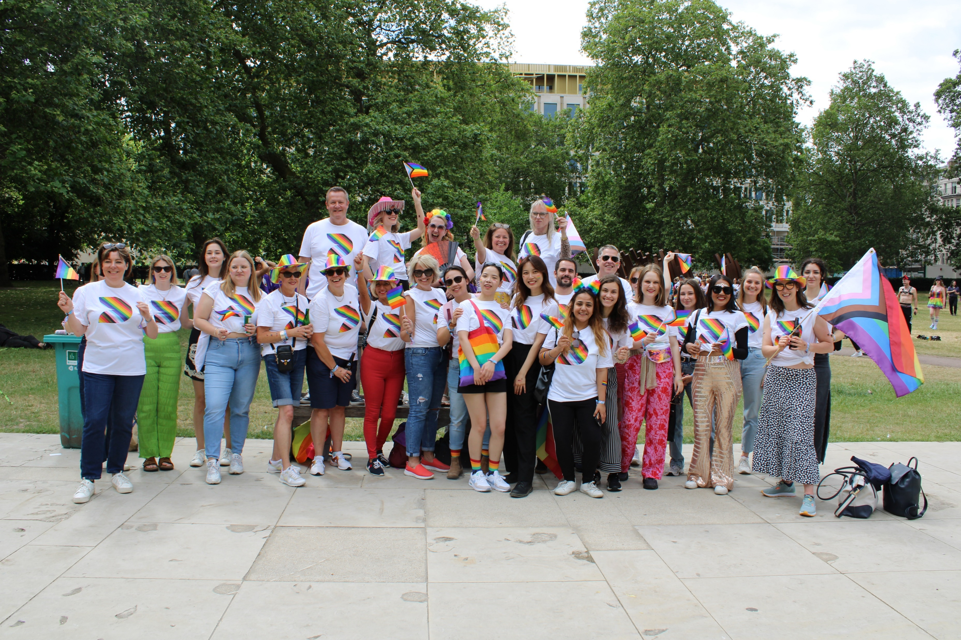
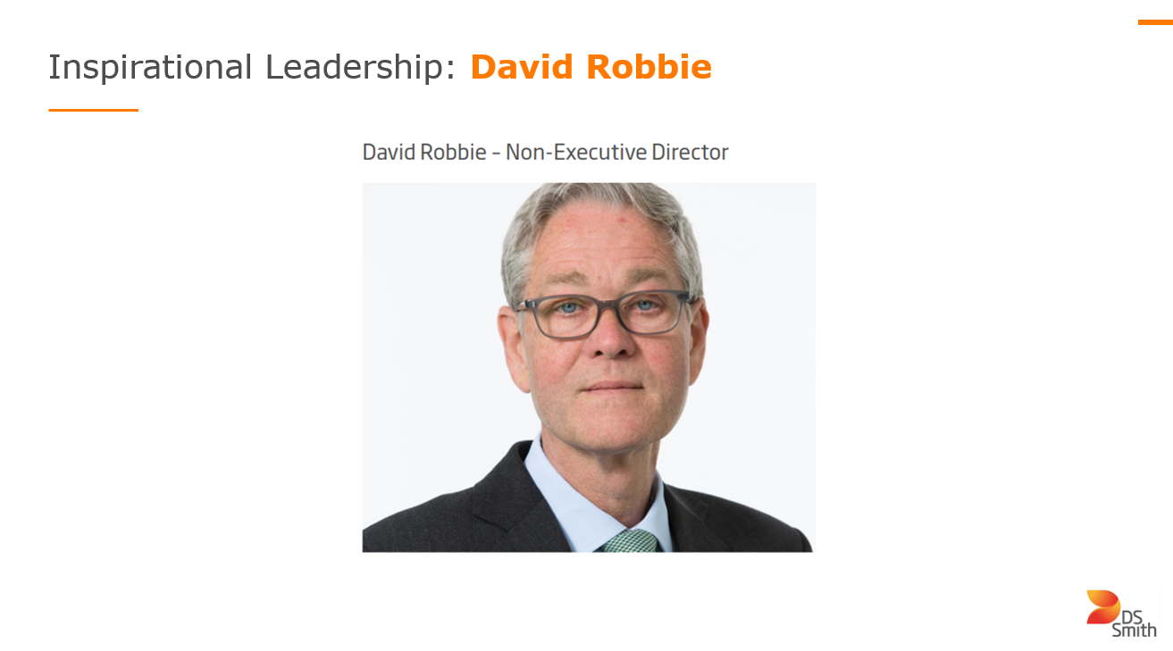

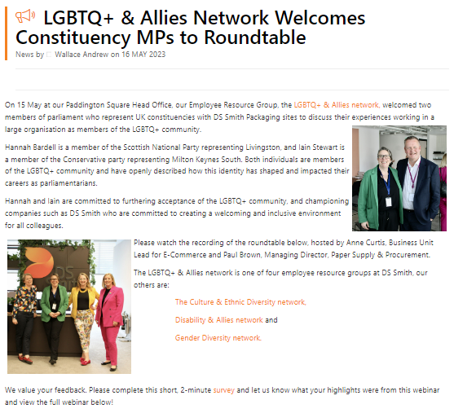
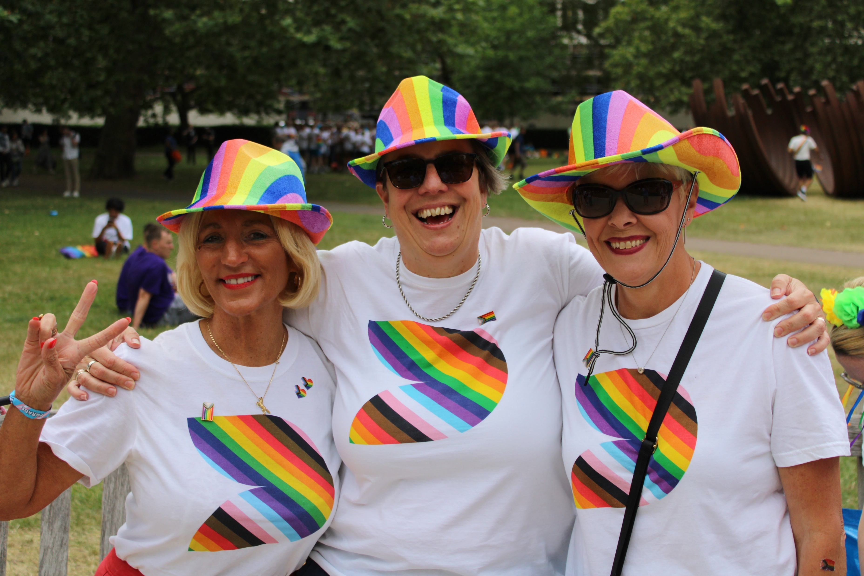

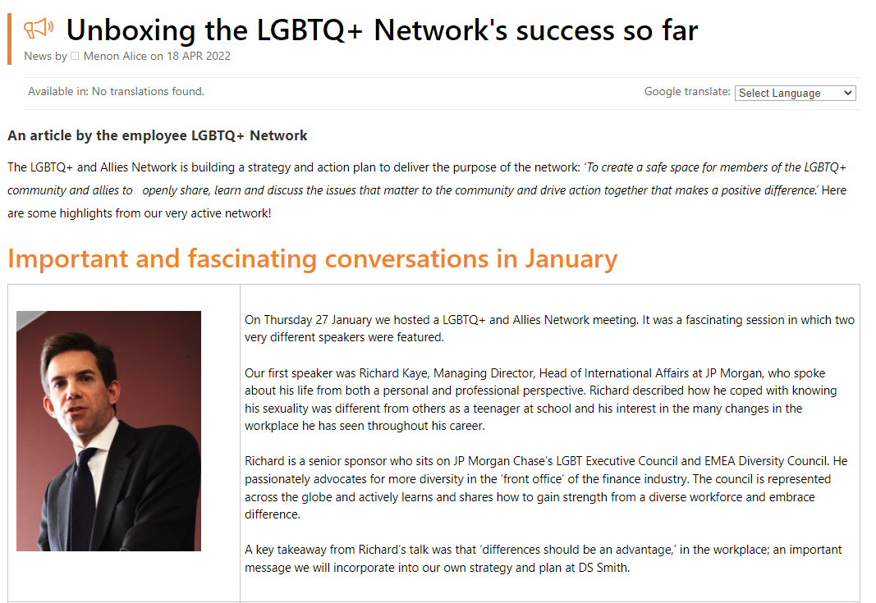
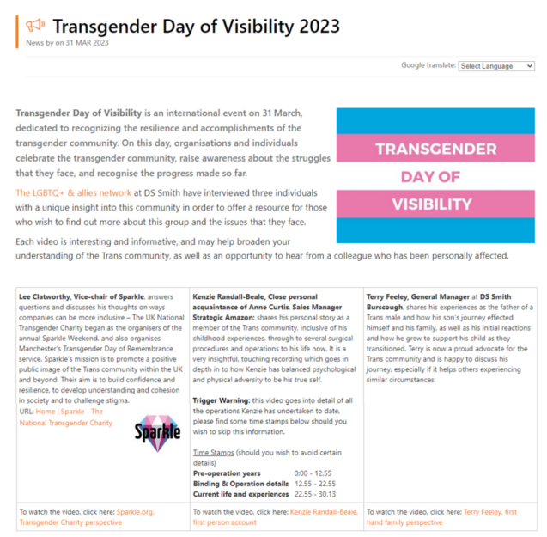
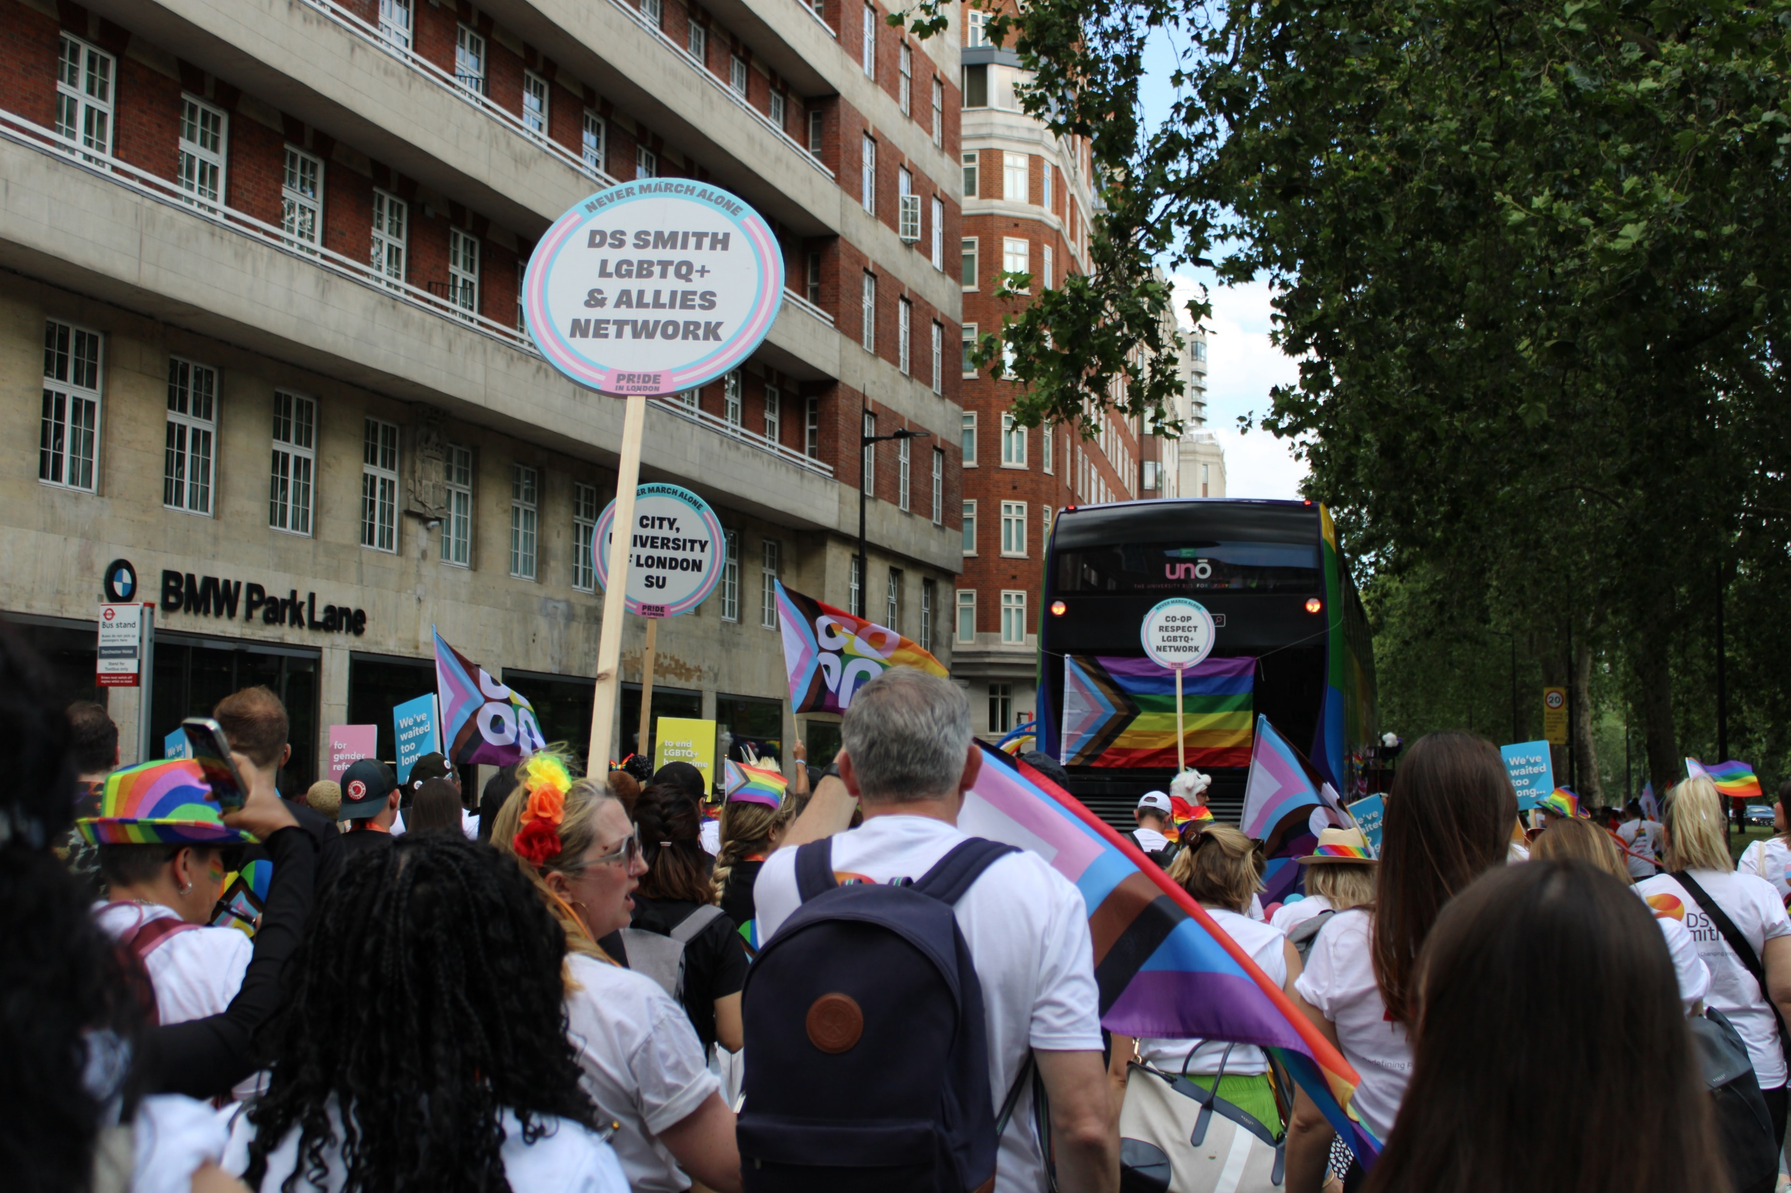
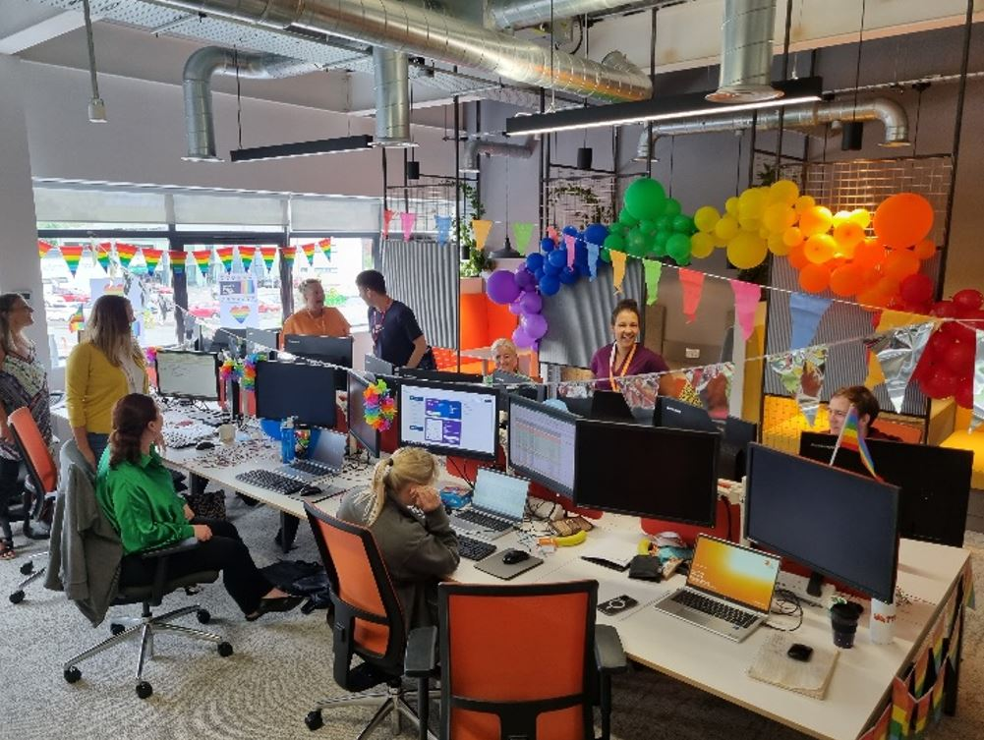
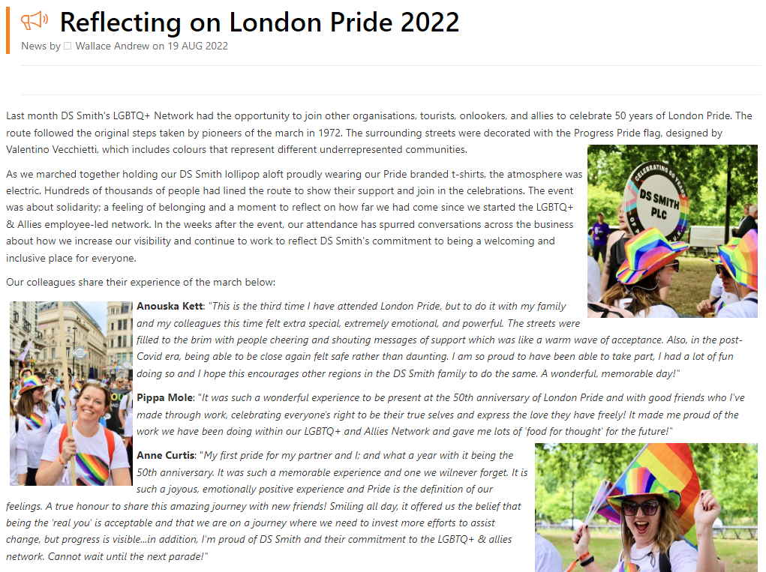
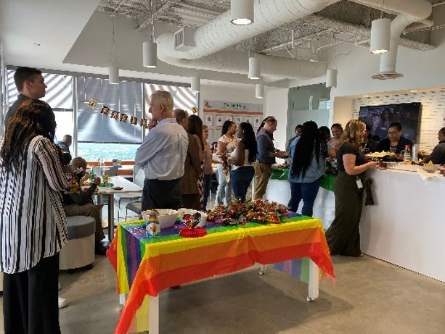
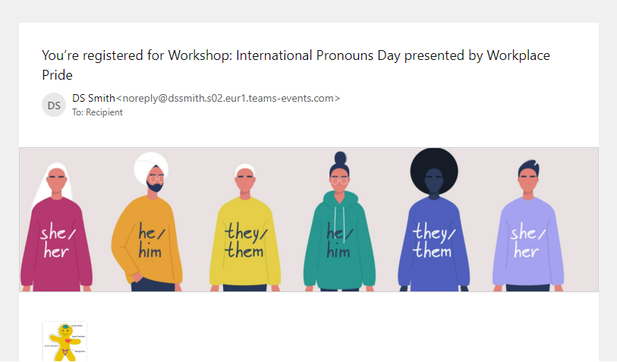
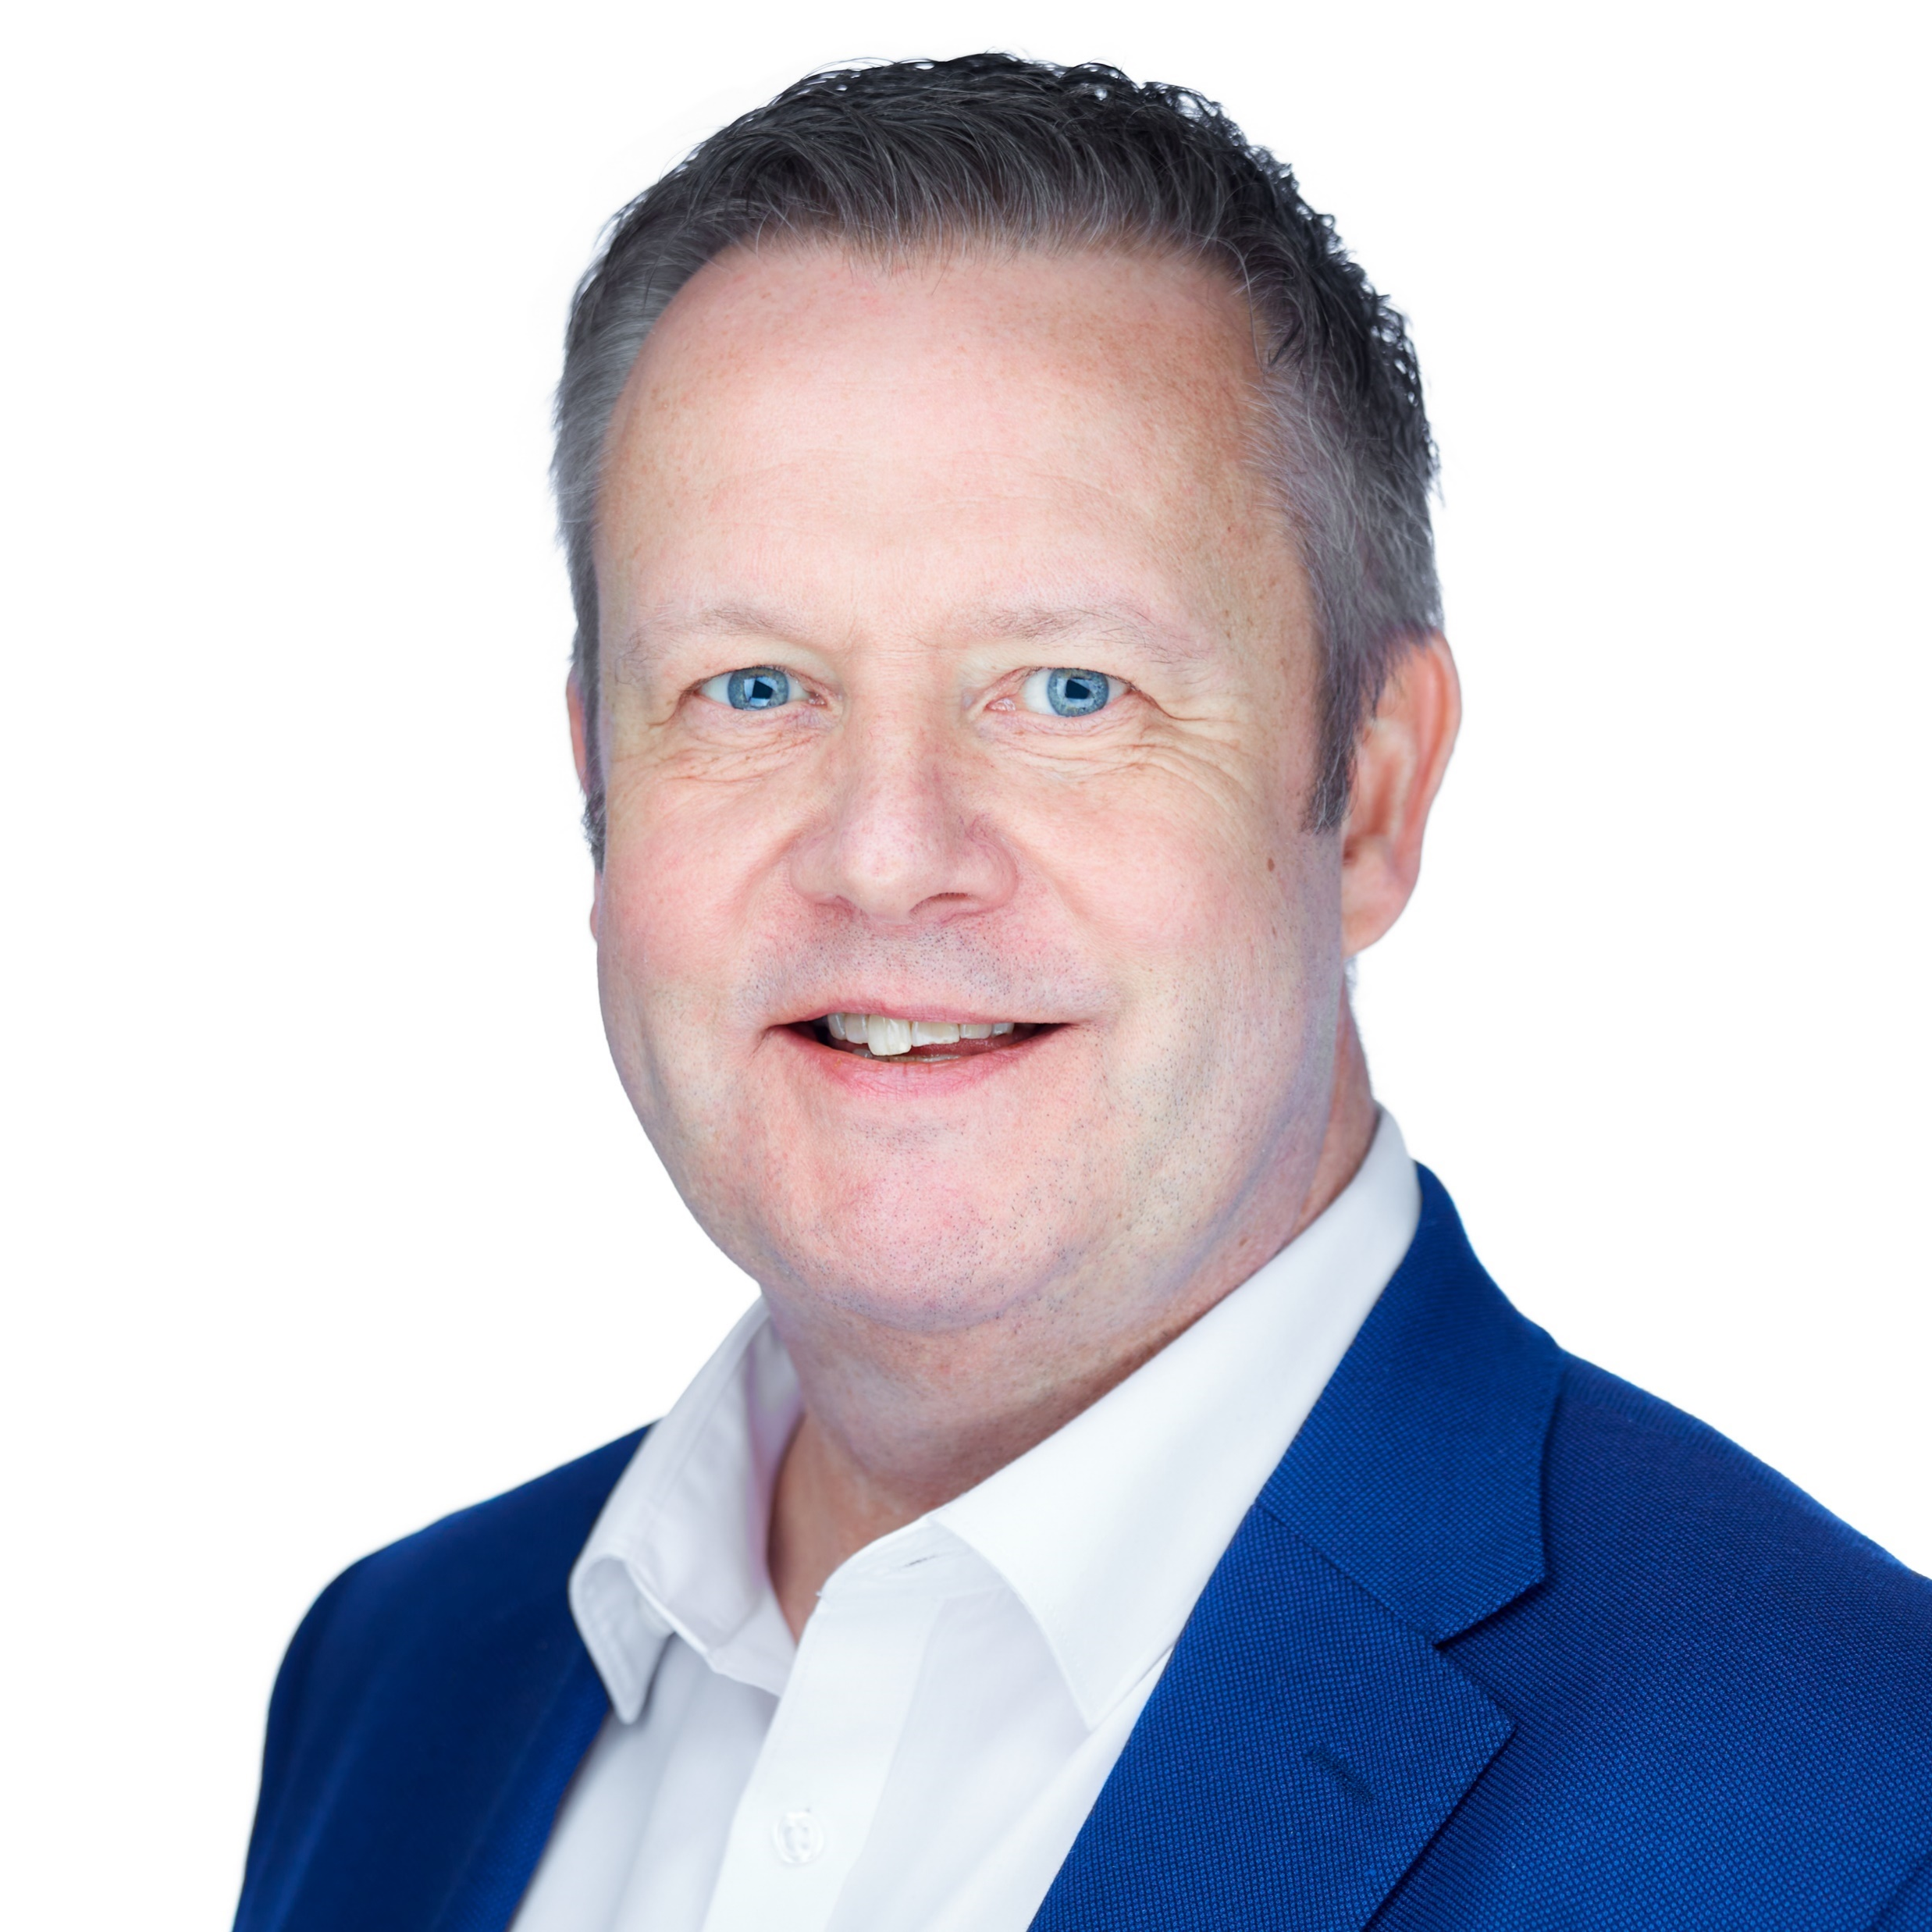
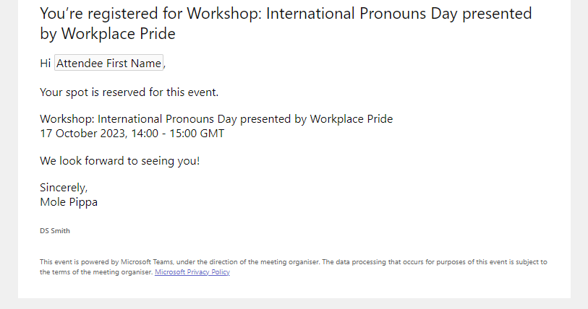
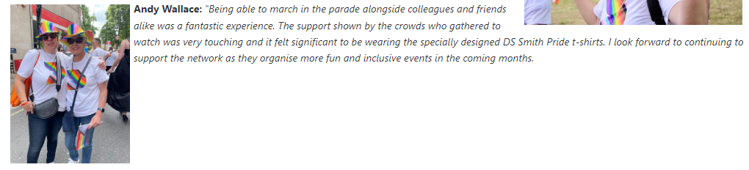
Reflections on past few years
Two webinars with influential LGBTQ+ community members
Joined Workplace Pride - May 2023
2021 - 2022
Plus a Q&A with a non-binary adolescent
London
Pride
2023
Supported and advised ‘Gender Diversity Network’ with their ‘Intl. Non-binary people’s day’ network call
2023
GOC Sponsor:
Paul Brown
Notes:
Questions for Paul:
What have you discovered since becoming part of the network?
What discussions do you have at GOC level about DEI? How can we support you?

Slide 78
Introduction to Gender & Beyond
Diversity, Equity & Inclusion
By the Gender Diversity Network

Slide 79
Ice Breaker
What is your concept of Gender?
Feel free to raise your hand to speak…

Slide 80

What is Gender Diversity?
Gender diversity refers to the presence of individuals from different gender identities or expressions within a group or organization, promoting inclusivity and representation of diverse perspectives and experiences. It recognizes that gender is not binary and encompasses a spectrum of identities beyond traditional male and female categories.

Slide 81

Understanding Gender Diversity: Terminology & Language
Definition: Gender Diversity refers to the variety of gender identities beyond the traditional binary of male and female.
Understanding Different Terminology
Biological Sex: Person’s physical being and biological attributes
Gender Expression: Influenced by societal norms, beliefs, and expectations
Gender Identity: Individual's deeply felt and experienced sense of their own gender
Sexual Orientation: Person's sexual orientation or their pattern of emotional, romantic, and/or sexual attraction to others
Notes:
Sources to share:
https://www.washingtonpost.com/world/2019/12/15/guide-how-gender-neutral-language-is-developing-around-world/
https://www.europarl.europa.eu/cmsdata/151780/GNL_Guidelines_EN.pdf
https://ilga-europe.org/blog/right-now-just-three-european-countries-recognise-non-binary-identities-but-others-are-pushing-forward/

Slide 82
Gender Stereotypes
What is stereotype?
A generalised view or preconception about attributes or characteristic that are possessed or the roles that are or should be performed, by members of a particular social group.
Women Stereotypes:
“Women are nurturing and caregivers”
“Women are weak and sensitive”
“Women are homemakers”
Men Stereotypes:
“Men are the breadwinner and provider”
“Men are strong and aggressive”
“Men should have a ‘Man Up’ mentality”
Non-Binary Stereotypes:
“Non-Binary’s are just confused”
“Non-Binary’s are androgynous”
“Non-Binary’s are just going through a phase”

Slide 83
How can stereotypes be harmful?
Harmful to Individuals:
Impacting their mental health and well-being, causing stress and low self-esteem
Narrow definitions of gender roles and behaviours can limit someone’s freedom to express themselves authentically
Underestimating the individual’s interests, abilities and talents
Reinforcing discriminatory behaviours and attitudes
Harmful to Society:
Reinforcing social inequalities by characterizing certain roles and behaviours to specific groups based on gender, race, ethnicity, sexual orientation, and other factors
Creating barriers to equal opportunities and access to resources for individuals who are stereotyped
Creating lack of trust amongst individuals and causing division and hostility

Slide 84
Group Discussion
How have stereotypes about gender affected your own life or the lives of people you know?
Feel free to raise your hand to speak…

Slide 85

Recap: Unconscious Bias
Unconscious bias is like a mental shortcut that our brains use to make quick judgments and decisions about people and situations without us even realizing it. These biases are influenced by our background, experiences, cultural environment, and societal stereotypes.
Imagine you're at a party and you meet someone new. Without even thinking about it, your brain might make quick assumptions about that person based on their appearance, accent, or the way they dress. These assumptions can be influenced by unconscious biases that we've picked up over time, like stereotypes about certain groups of people.
Unconscious bias can affect our behaviour in subtle ways, like who we choose to socialize with, who we hire for a job, or even who we trust.

Slide 86







Example of Unconscious Bias

Slide 87
Examples of Gender Bias at the Workplace
Assuming certain jobs are more suitable for one gender over another
The gender wage gap exists across many industries and is a result of factors such as unconscious bias in salary negotiations, and discrimination
Structural barriers at the workplace can make it difficult for minority genders to further advance in their careers due to the biases
Holding men, women and non-binary individuals to different standards of behaviour
Policies and practices related to parental leave may reinforce gender stereotypes and disadvantage women in the workplace
Unconscious biases may influence performance evaluations, leading to disparities in feedback, ratings, and opportunities for advancement

Slide 88
Group Reflection
Any final thoughts?
Feel free to raise your hand to speak…

