Slide 1
Biodiversity Lesson Plan Information
Niki Gajjar | NAPP Sustainability
Earth Day, April 2023!
02.14.2023

Slide 2
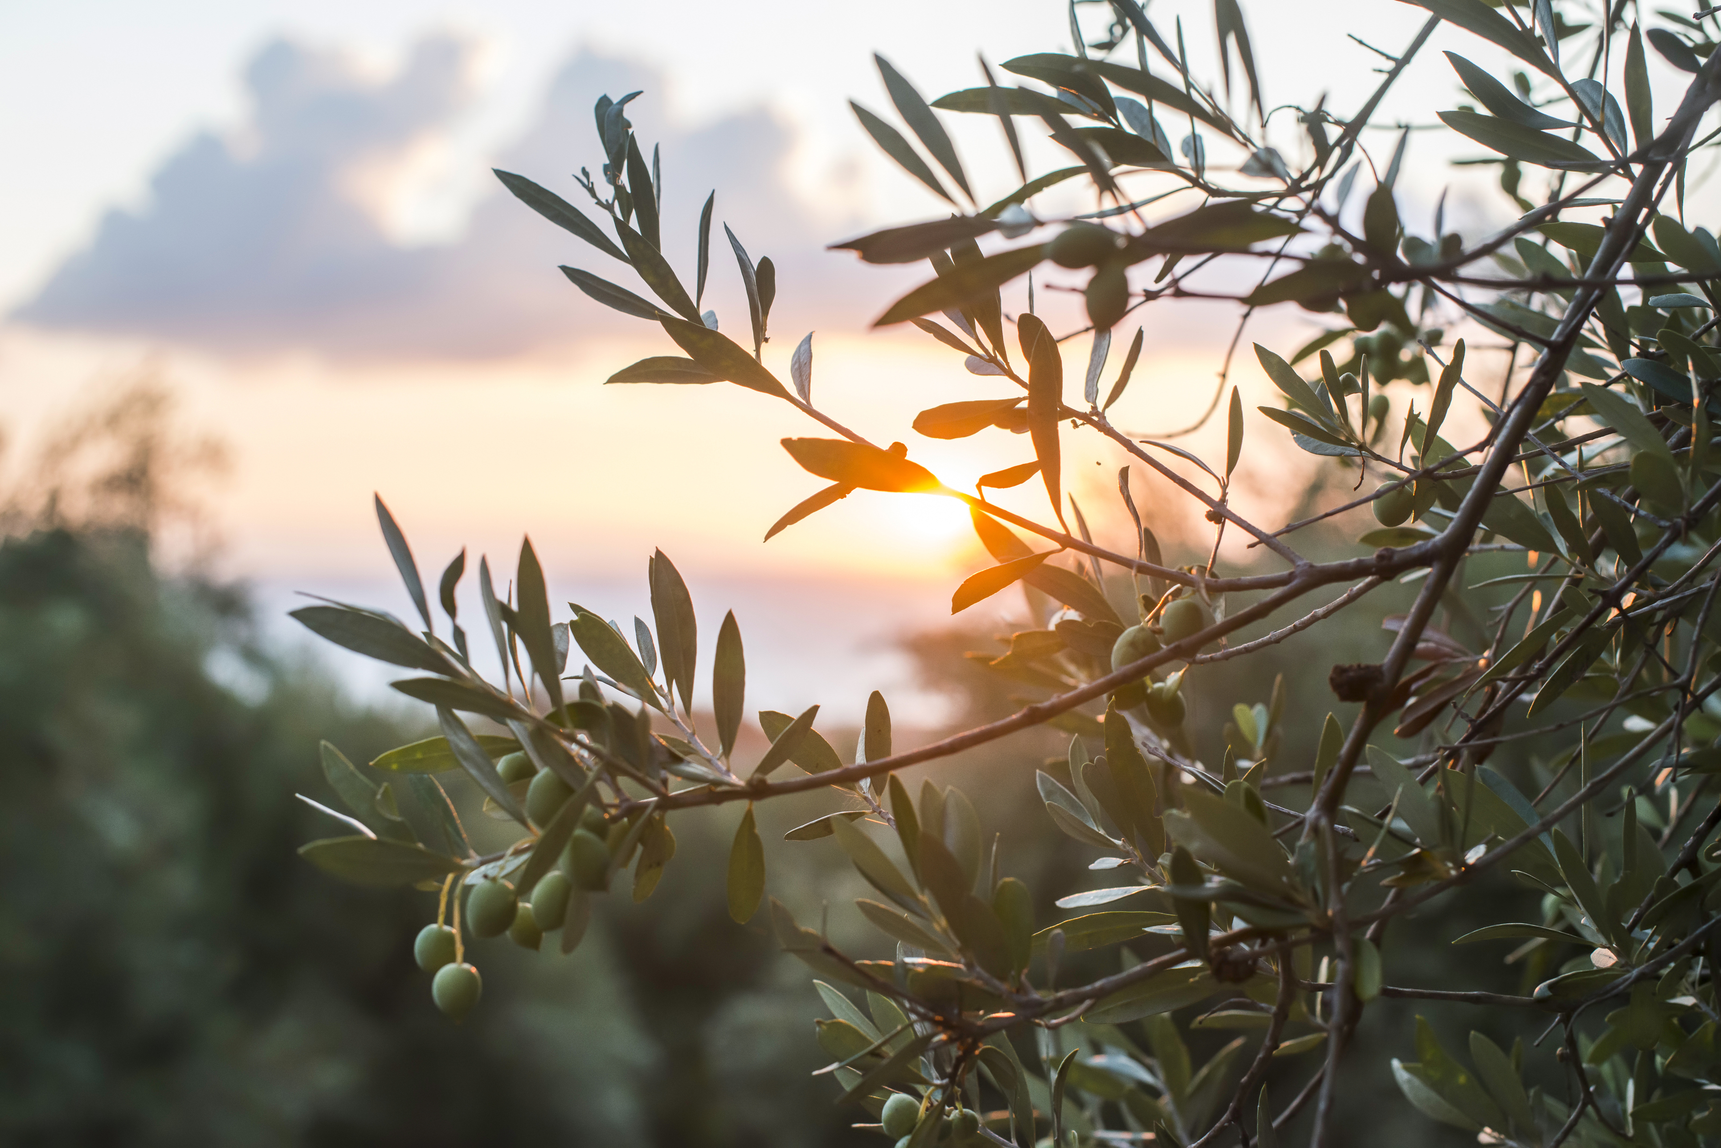
Age range: 5-11 years (K-5)
Interactive, fun, activity-filled!
Available for anyone interested in sharing with a school or local club!
To teach students about the diversity of life and ecosystems on Earth, and to leave with an understanding of threats and protections for biodiversity.
Total time: 45-60 minutes
Reach out to Niki Gajjar – niki.gajjar@dssmith.com for more information

Slide 3
The lesson plan includes speaker notes, objectives and overview, slide deck, and printable activity sheets!

Slide 4
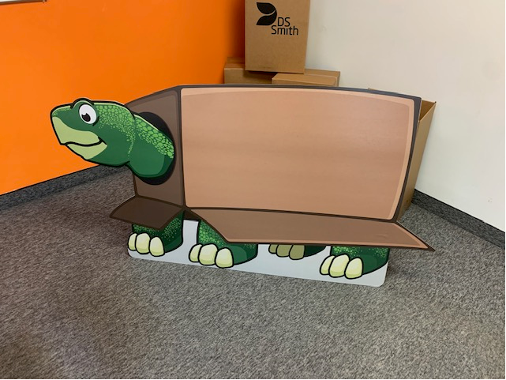
NAPP is the pilot for the lesson plan, and it will eventually be rolled out to the rest of the business.

