Slide 1
Product Presentation

Slide 2
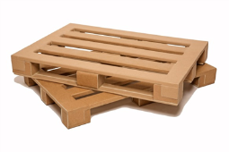
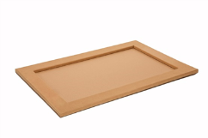
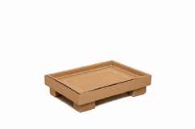
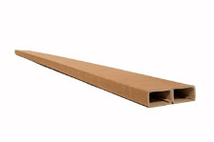
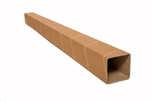
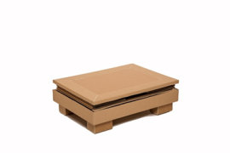
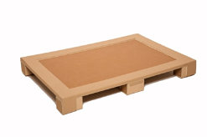
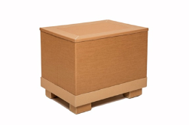
A unique solution for you
We are #PackagingStrategists, delivering results.

Slide 3
About DS Smith The European leading packaging company
Who we are
One of our core objectives is to 'delight our customers’ – this defines the road forward for DS Smith.
We are leading the packaging sector because we understand that we need to create solutions for our customers that look at the whole, not just one part.
Offering
Whatever your packaging needs, DS Smith is your ideal strategic partner. We have different product types that serve a variety of segments. Packaging is not only a product but a real technology which involves concepts of protection to presentation for sale. As a packaging imagineers and supply-cycle specialists, we focus on saving you time and reducing costs to improve your efficiency.
We are #PackagingStrategists, delivering results.

Slide 4
About DS Smith The European leading packaging company
Strategists
DS Smith’s Packaging Strategists work in partnership with customers to deliver value through exceptional packaging performance at every stage of the supply cycle. Whatever your packaging needs, we will help you increase sales, lower costs and manage risks.
We are #PackagingStrategists, delivering results.

Slide 5
Business Model of DS Smith
Focused on sustainable packaging
We bring insight and innovation, and use this to design the optimum packaging for our customers’ supply chains, then manufacture it to the highest standard.
To support the production of high quality, cost effective corrugated packaging, we manufacture paper and have a recycling business to source fibre for this activity. We design and manufacture specialised lightweight paper grades to produce the highest performing packaging from the least amount of fibre.
We also design and manufacture certain types of speciality plastic packaging, in particular plastic bags and taps for bag-in-box packaging and rigid crates for bottled liquids.
Packaging
Recycling
Paper
Plastic
We are #PackagingStrategists, delivering results.

Slide 6
A unique solution for you
We have an innovative and smart solution for your logistics & business.
We developed an unbeatable product family for you with the name of DS Smith PaPillOn which includes a paper based pallet, a container, a top deck and other integrated systems.
We are #PackagingStrategists, delivering results.

Slide 7
The name “PaPillOn”
Whilst ‘PaPillOn’ means butterfly in French, the name tells all the benefits:
‘Pa’ stands for the paper-made solution
‘Pill’ stands for a strong pillar
‘On’ stands for the light-weight result
We are #PackagingStrategists, delivering results.

Slide 8
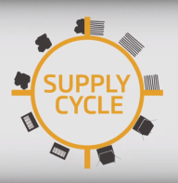
Unique innovation
DS Smith PaPillOn is made of 100% recycled paper, converted into a special shape which is a unique innovation in the industry.
Only eco-friendly materials are used for production
Despite of wooden pallets, you do not have to worry about mould and microorganisms. No dust, no dirt - the cleanliness is guaranteed.
We are #PackagingStrategists, delivering results.

Slide 9
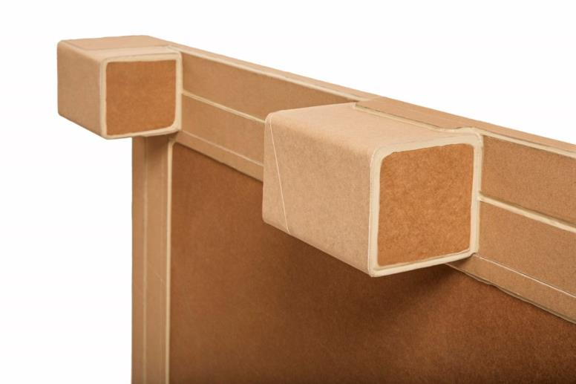
A unique solution for you
We are #PackagingStrategists, delivering results.

Slide 10
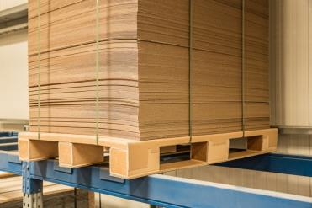
Strong
Need to carry 1000 kg? Not a problem at all.
One of the greatest features of DS Smith PaPillOn is its strength
It’s made of recycled paper with patented forming technology, so that DSS PaPillOn Pallet is perfect to load up to 1000 kilograms
As strong as wood, DSS PaPillon Pallet is the strongest paper pallet on the market
We are #PackagingStrategists, delivering results.

Slide 11
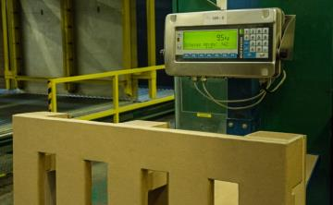
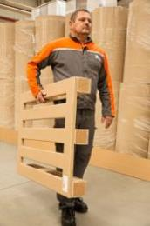
Light
Weighs only 7 to 10 kilograms.
DSS PaPillOn Pallet is less than half-weight of wooden pallets
This is the main reason why you can decrease your transport costs and environmental taxes
We are #PackagingStrategists, delivering results.

Slide 12
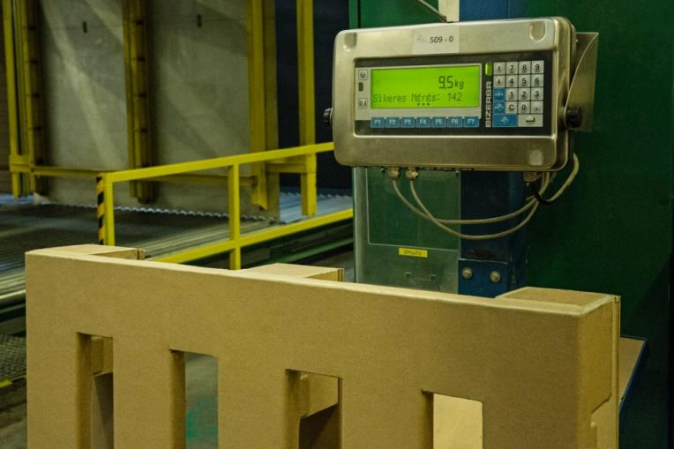
We are #PackagingStrategists, delivering results.

Slide 13
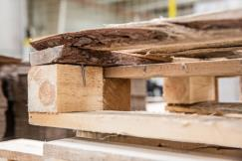
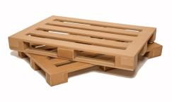
Clean
No dust, No dirt.
When you are using DS Smith PaPillOn you do not have to worry about mould and microorganisms
The cleanliness is guaranteed without heat treatment
It has no nails and staples, so the risk of the injuries is lower than in case of using wooden pallets
No risk or impact on supply by wheather conditions or country specific issues (like on wooden markets)
We are #PackagingStrategists, delivering results.

Slide 14
We are #PackagingStrategists, delivering results.

Slide 15
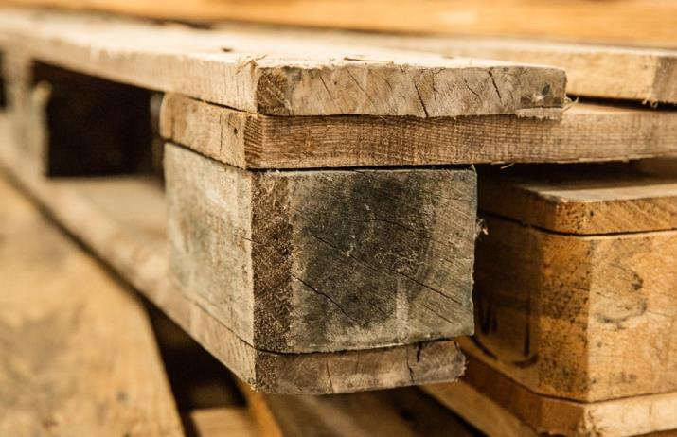
We are #PackagingStrategists, delivering results.

Slide 16
We are #PackagingStrategists, delivering results.

Slide 17
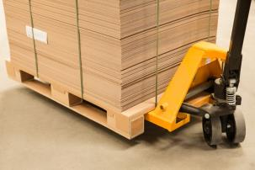
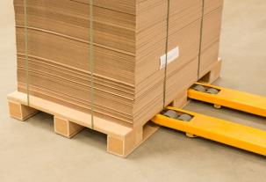
Flexible
Tailored to your business needs.
Due to the unique construction of the profile, DS Smith PaPillOn is extremely strong and massive but also flexible in construction and size
No supply risk – papers are standard with numerous sources
The DSS PaPillOn Pallet fits into fork-lifts, pallet jacks and conveyor belt system
We are #PackagingStrategists, delivering results.

Slide 18
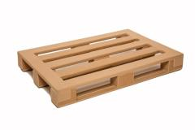
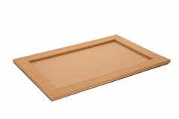
Products
We are #PackagingStrategists, delivering results.

Slide 19
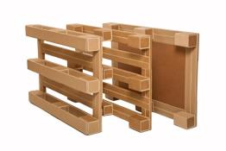
DSS PaPillOn Pallet
The strongest paper pallet ever
The DSS PaPillOn Pallet has the same functionality and features as standard EUR pallet
However, it is available in three different types
It is easy and ergonomic for handling
Despite wooden pallets, no heat treatment is needed
We are #PackagingStrategists, delivering results.

Slide 20
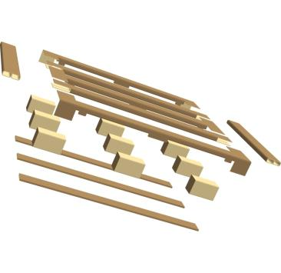
The construction
Without Bottom Deckboard
With Bottom Deckboard
We are #PackagingStrategists, delivering results.

Slide 21
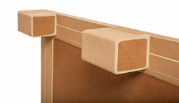
Product features
Width: 800mm
Length: 1200mm
Height: 144mm
Weight: 7-10 kgs, depends on final construction
Lifting: Possible from all 4 directions
Loading weight: 1000 kgs
Storage: on floor or on shelves
Transport: fits to forklifts, pallet jack, conveyor belt systems
DSS PaPillOn Pallet is a paper based pallet. The pallet has 9 blocks and no bottom slices.
Using paper for production:
All type of papers can be used kraftliner – testliner or GD grades.
No special paper is required. Can be provided from all paper suppliers – no supply risk.
Glue:
Cold glue (in the winding machine process) and hot melt for other assembling lines.
Specification of the glue is available for DS Smith PaPillOn products.
We are #PackagingStrategists, delivering results.

Slide 22
Product features
Width: 800mm
Length: 1200mm
Height: 144mm
Weight: 7-10 kgs, depends on final construction
Lifting: Possible from all 4 directions
Loading weight: 1000 kgs
Storage: on floor or on shelves
Transport: fits to forklifts, pallet jack, conveyor belt systems
We are #PackagingStrategists, delivering results.

Slide 23
Product features
DSS PaPillOn Pallet is a paper based pallet. The pallet has 9 blocks and no bottom slices.
Using paper for production:
All type of papers can be used kraftliner – testliner or GD grades.
No special paper is required. Can be provided from all paper suppliers – no supply risk.
Glue:
Cold glue (in the winding machine process) and hot melt for other assembling lines.
Specification of the glue is available for DS Smith PaPillOn products.
We are #PackagingStrategists, delivering results.

Slide 24
Product features
We are #PackagingStrategists, delivering results.

Slide 25
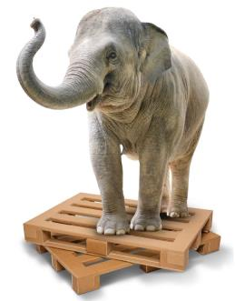
Tests with DSS PaPillOn Pallet
Loading test:
We made a loading test on a flat surface.
Loaded 5 tons on DSS PaPillOn Pallet.
DSS PaPillOn Pallet passed the test, there was no damage at 50089N.
We are #PackagingStrategists, delivering results.

Slide 26
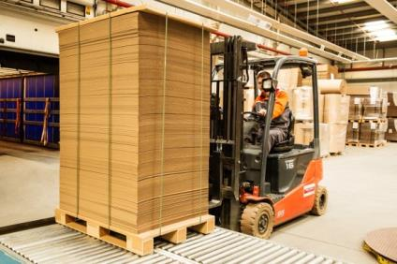
Tests with DSS PaPillOn Pallet
Forklift test:
We loaded DSS PaPillOn Pallet over 500kgs and carried it with a forklift.
DSS PaPillOn Pallet passed the test, there was no damage.
We are #PackagingStrategists, delivering results.

Slide 27
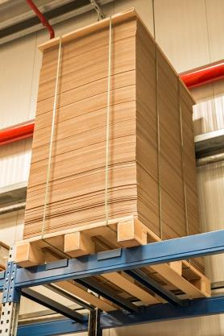
Tests with DSS PaPillOn Pallet
Shelf test:
We loaded DSS PaPillOn Pallet by 3918N (ca. 400kgs) between supporting shelves.
DSS PaPillOn Pallet passed the test, there was no damage.
We are #PackagingStrategists, delivering results.

Slide 28
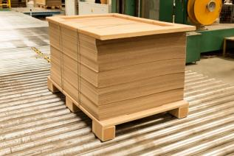
Tests with DSS PaPillOn Pallet
Transport test:
We put DSS PaPillOn Pallet on vibration at 2,3Hz, for 1 hour, loaded with 600kgs.
DSS PaPillOn Pallet passed the test, there was no damage.
We are #PackagingStrategists, delivering results.

Slide 29
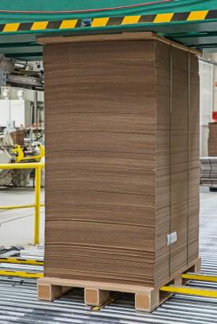
Tests with DSS PaPillOn Pallet
Automated packing machine test:
We loaded DSS PaPillOn Pallet with 400kgs, and pushed it by hydraulic positioning system.
DSS PaPillOn Pallet passed the test, there was no damage.
We are #PackagingStrategists, delivering results.

Slide 30
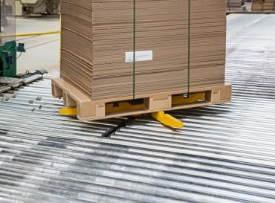
Tests with DSS PaPillOn Pallet
Conveyor test:
We put DSS PaPillOn Pallet on moving conveyors with different diameter rolls and loaded with 400kgs.
DSS PaPillOn Pallet passed the test, there was no damage.
We are #PackagingStrategists, delivering results.

Slide 31
DSS PaPillOn Container
It can be tailored to your business needs
The DSS PaPillOn Container can be optimised for one way or multi-rotational use
The solution is partly or entirely based on DS Smith PaPillOn profile and can be flexibly tailored (in size and construction) to your needs
We are #PackagingStrategists, delivering results.

Slide 32
Product features
We are #PackagingStrategists, delivering results.

Slide 33
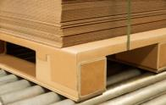
DSS PaPillOn Top Deck
Your product is secured
The DSS PaPillOn Top Deck is unbreakable
All through shipping, the banding do not damage the product even the DSS PaPillOn Top Deck
It helps you to protect your goods when stacking them up
We are #PackagingStrategists, delivering results.

Slide 34
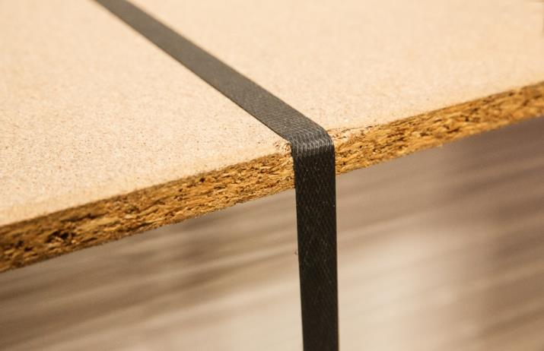
DSS PaPillOn Top Deck
We are #PackagingStrategists, delivering results.

Slide 35
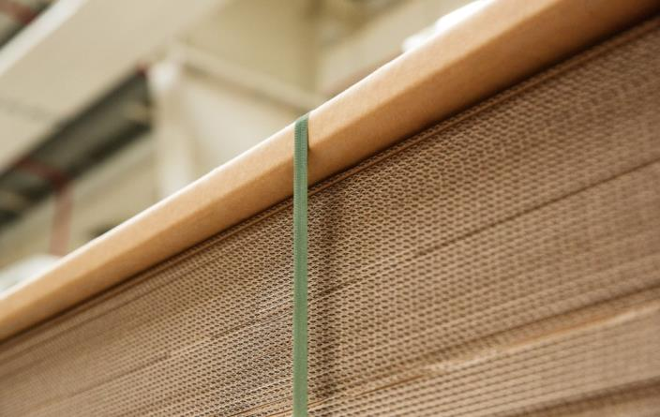
DSS PaPillOn Top Deck
We are #PackagingStrategists, delivering results.

Slide 36
DSS PaPillOn Top Deck
We are #PackagingStrategists, delivering results.

Slide 37
DSS PaPillOn Top Deck
We are #PackagingStrategists, delivering results.

Slide 38
Find us
If you fancy getting more information about DS Smith PaPillOn contact DS Smith Packaging:
Phone: +36 (30) 5045801
E-mail: papillon@dssmith.com
Web: www.dssmith.com/papillon
We are #PackagingStrategists, delivering results.

